Slide 1
Less than a 100 cases worldwide
BAM Syndrome
Dr Ahmed Refaie, Dr Ahmed Al Fadhly, Dr Abdulla Alkhaldi, Dr Omar Abdelaty.

Slide 2
Bosma arhinia microphthalmia syndrome
37 wks fullterm new born with dysmorphic features.
BAMS is a rare genetic disorder characterized by congenital arhinia (absence of the nose) and microphthalmia (abnormally small eyes). Associated features include anosmia, midface hypoplasia, cleft palate, hypertelorism, choanal atresia, and genital anomalies such as hypogonadism. Cognitive development is typically unaffected, though some individuals may experience hearing loss.
BAMS is linked to mutations in the SMCHD1 gene, which plays a role in craniofacial development. It follows an autosomal dominant inheritance pattern with incomplete penetrance, though de novo mutations are common.
Treatment is multidisciplinary, addressing functional, aesthetic, and associated anomalies. Surgical reconstruction of nasal structures is complex and staged. Management of microphthalmia may include prosthetic eyes, while cleft palate and choanal atresia often require surgical correction. Hormone replacement therapy is used for hypogonadism.
Prognosis is generally good, as the syndrome does not typically involve life-threatening complications. However, quality of life may be impacted by the need for multiple surgeries and ongoing management. With early diagnosis and coordinated care, individuals can achieve good functional and psychosocial outcomes, leading independent lives.

Slide 3
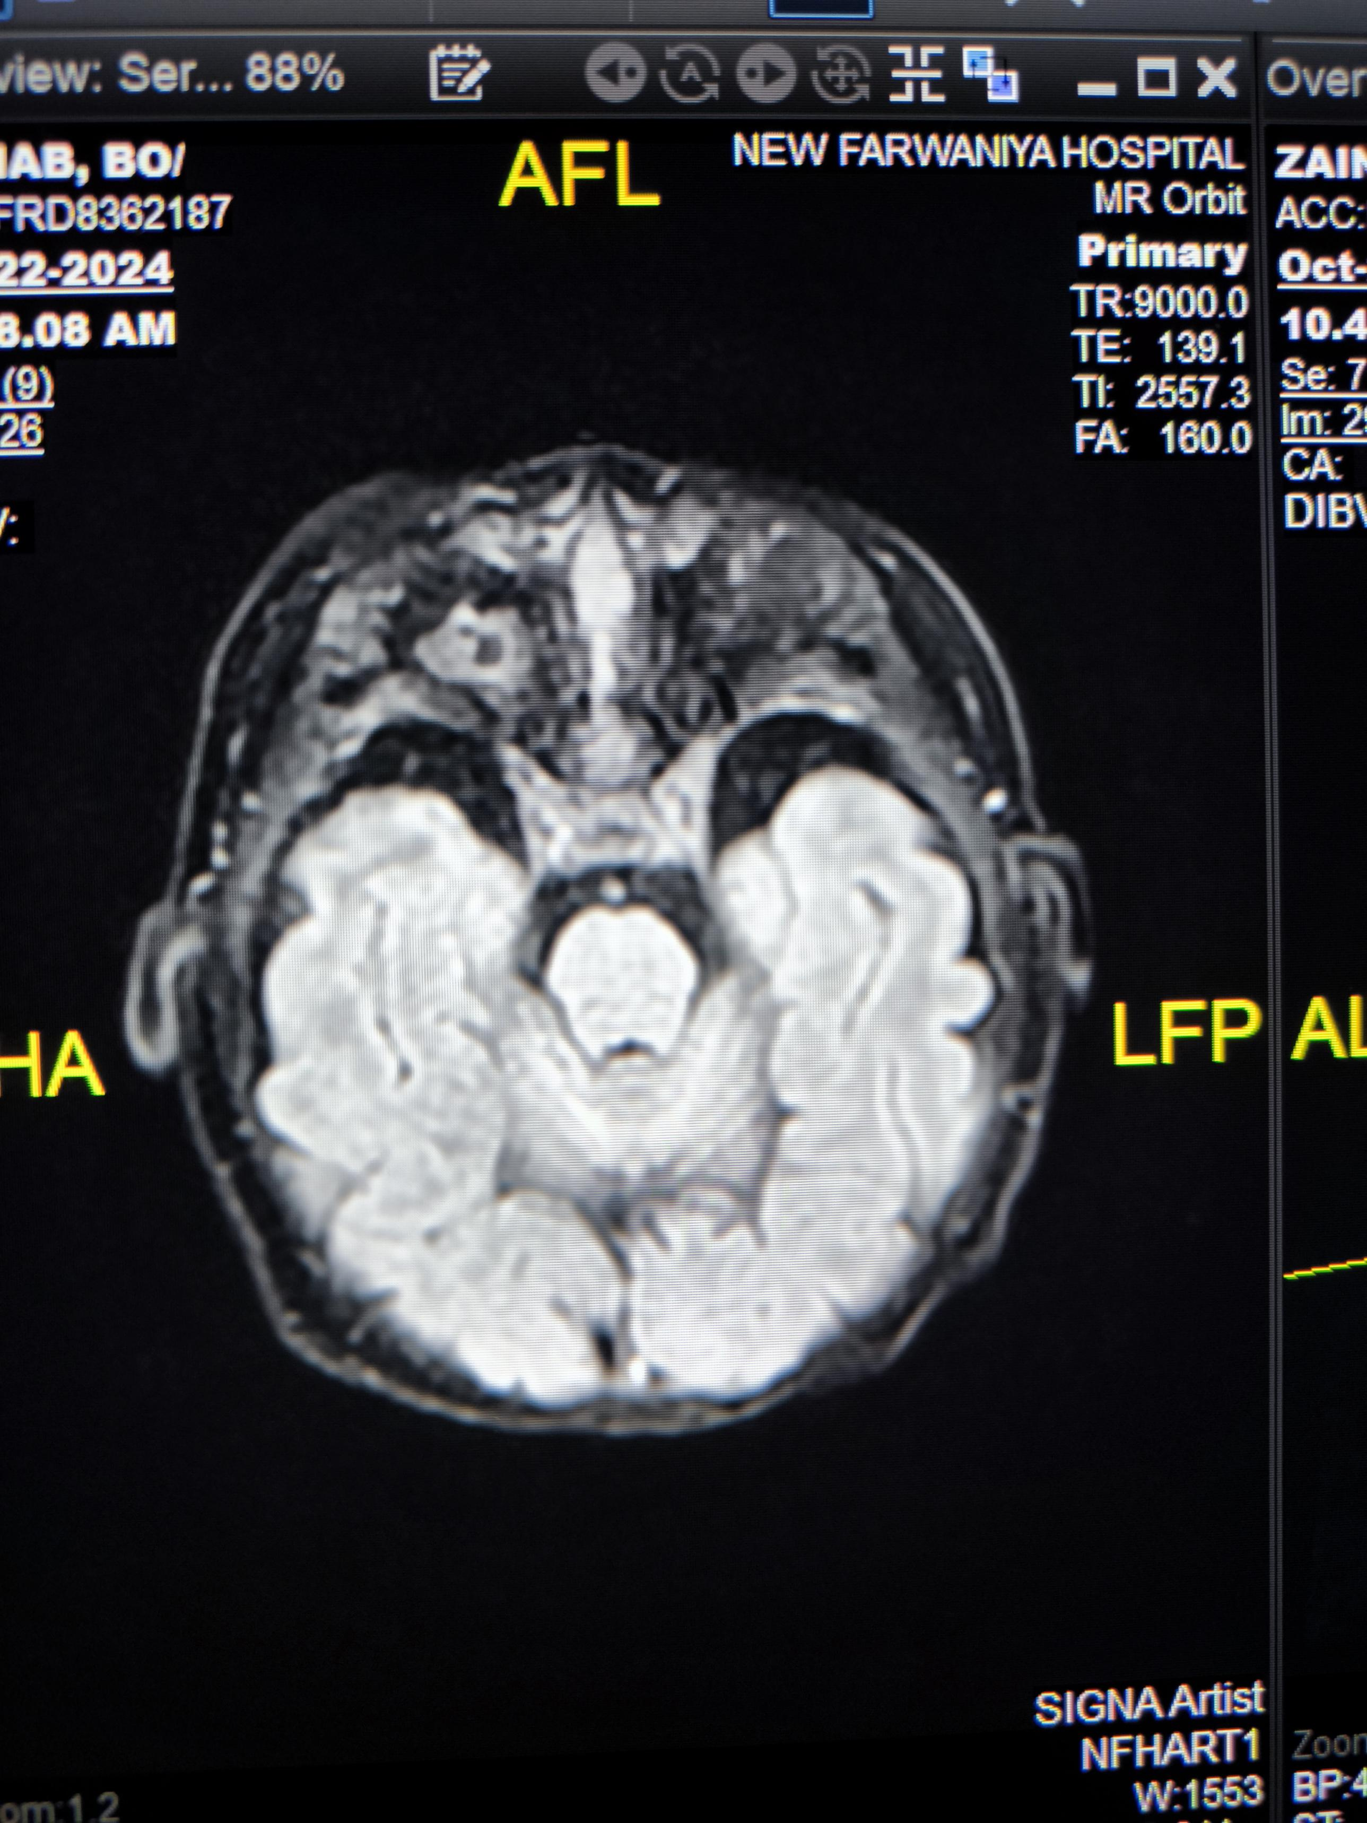
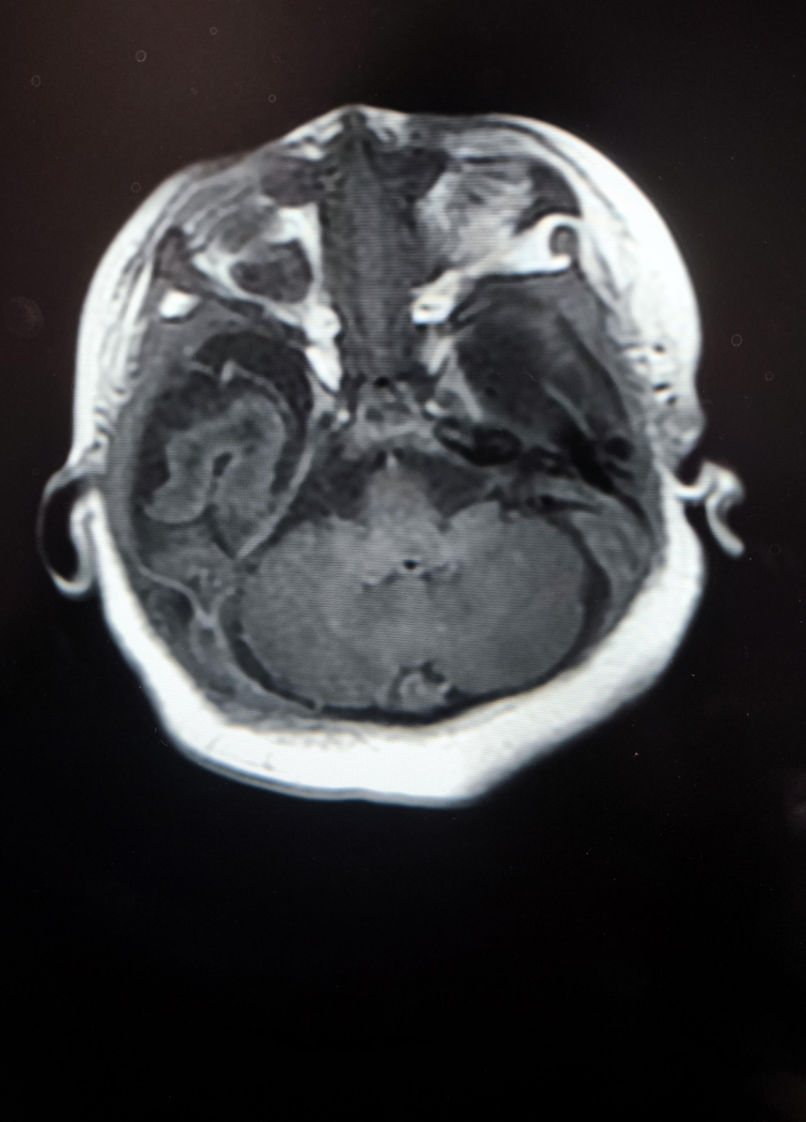
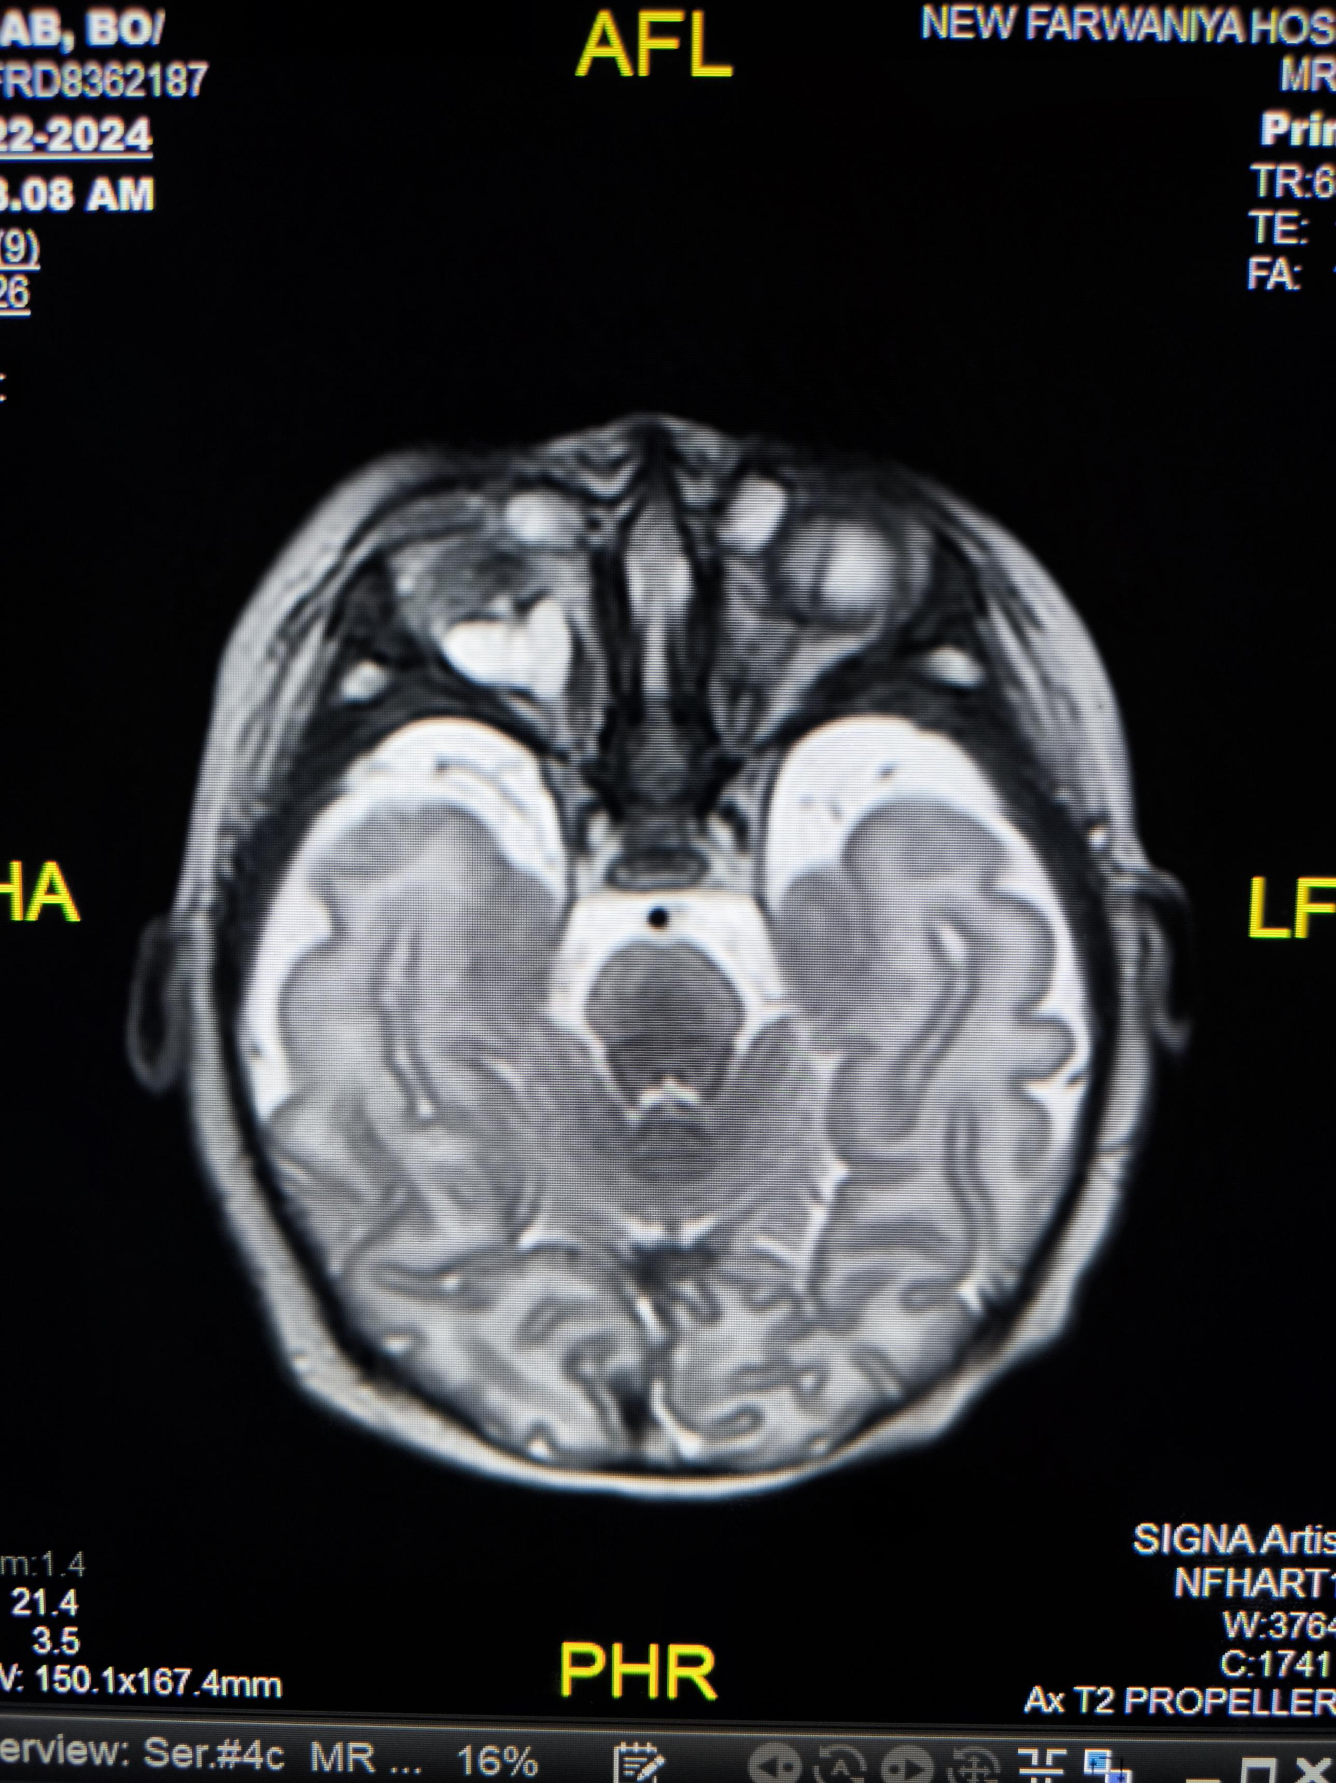
Sag T1
Axial T1 +C
Axial T2
Axial T1+C & axial T2 reveal a well defined cystic lesion intraconal intra occular location eliciting high T2 signal and low T1 with no post contrast enhancement (arrow thin)
Axial T2 showing relatively small right eye globe with both lens dislocated into he viterous

Slide 4
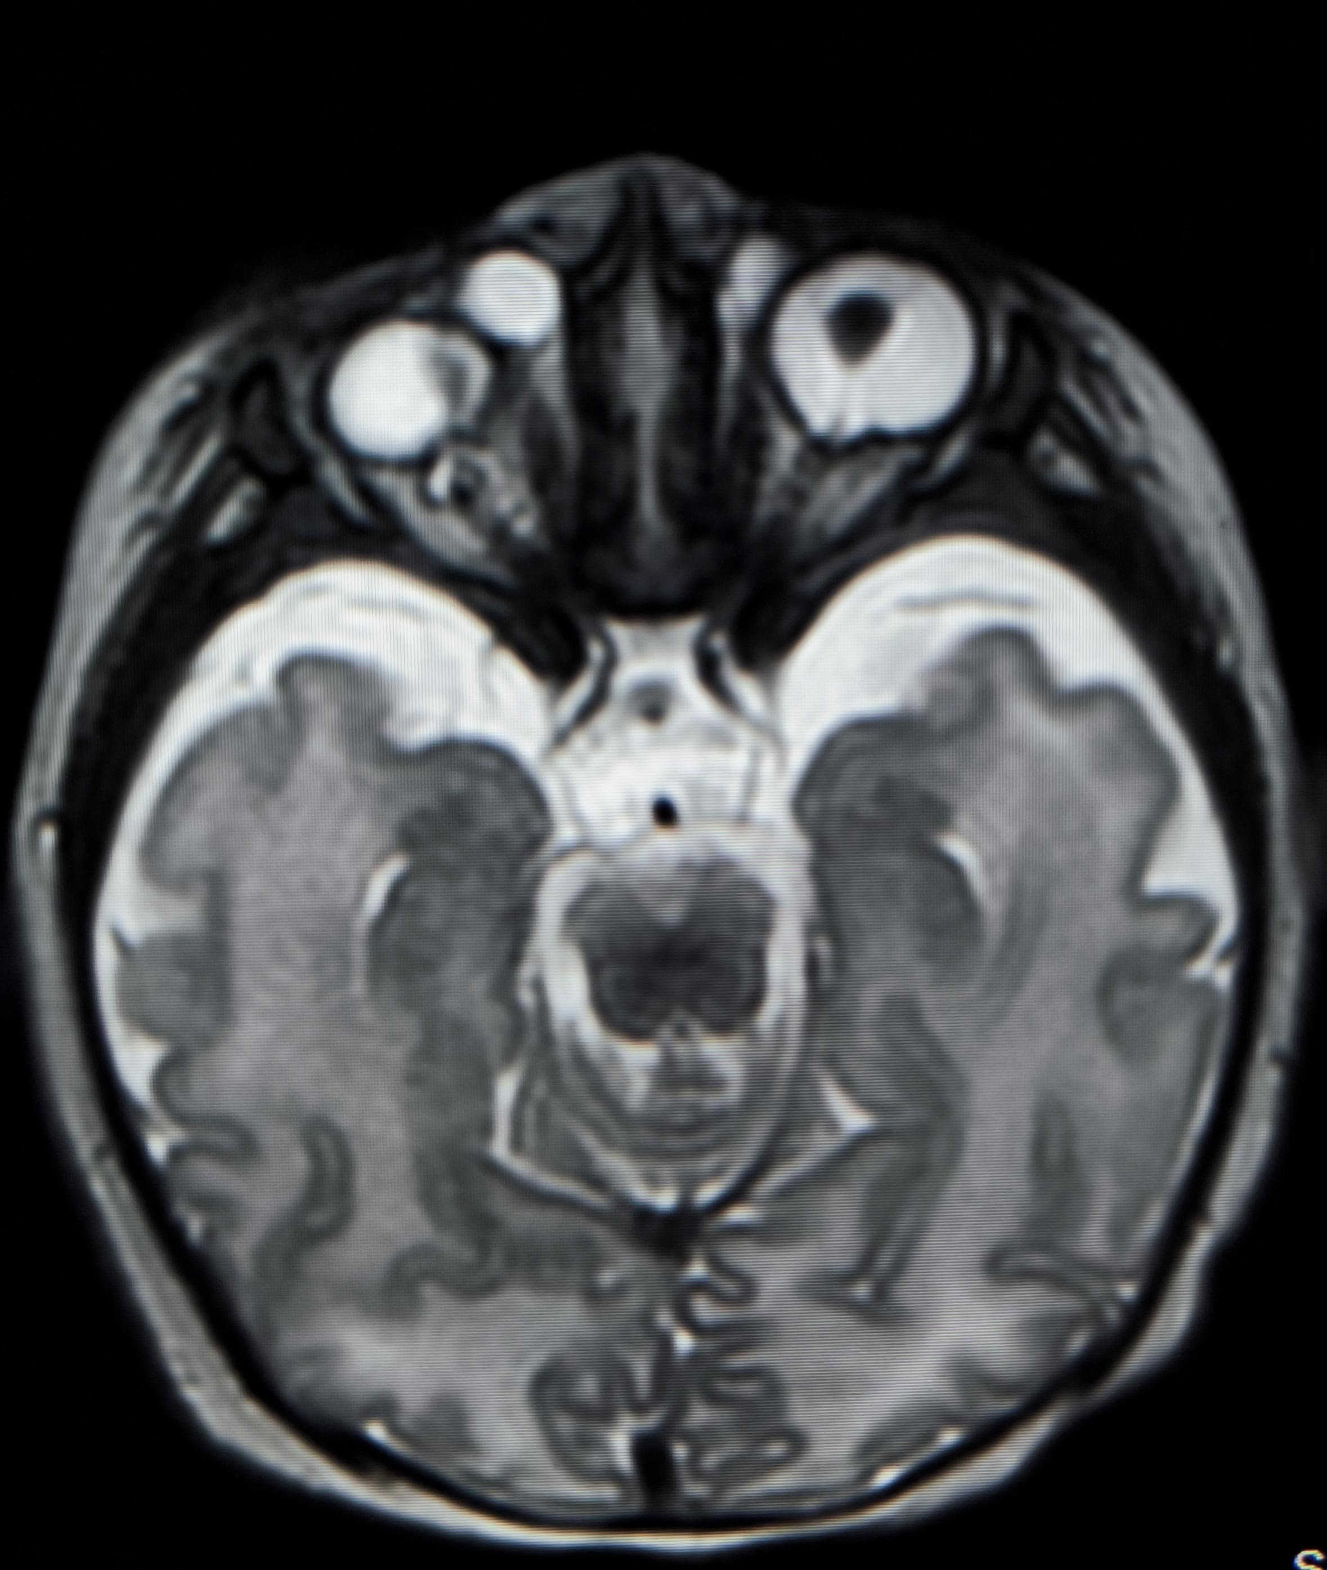
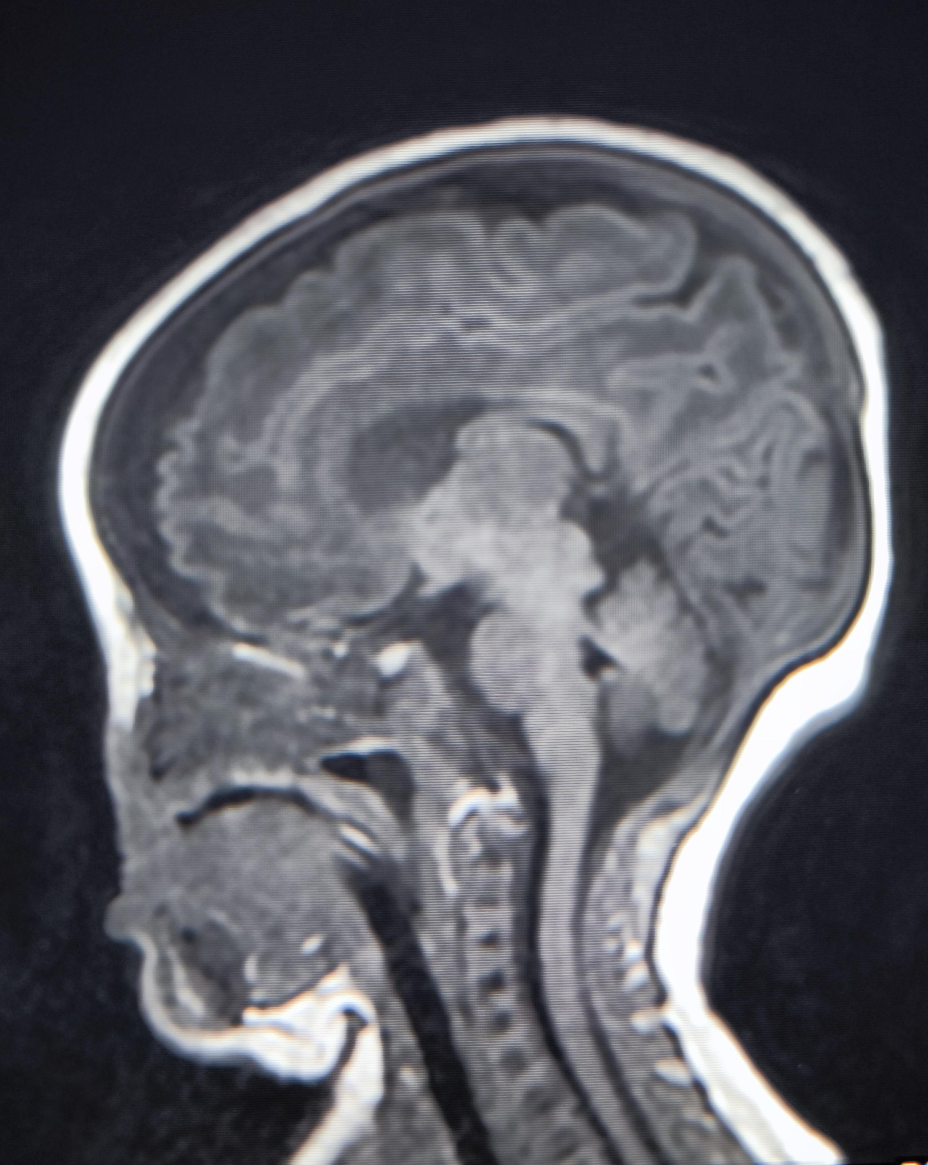
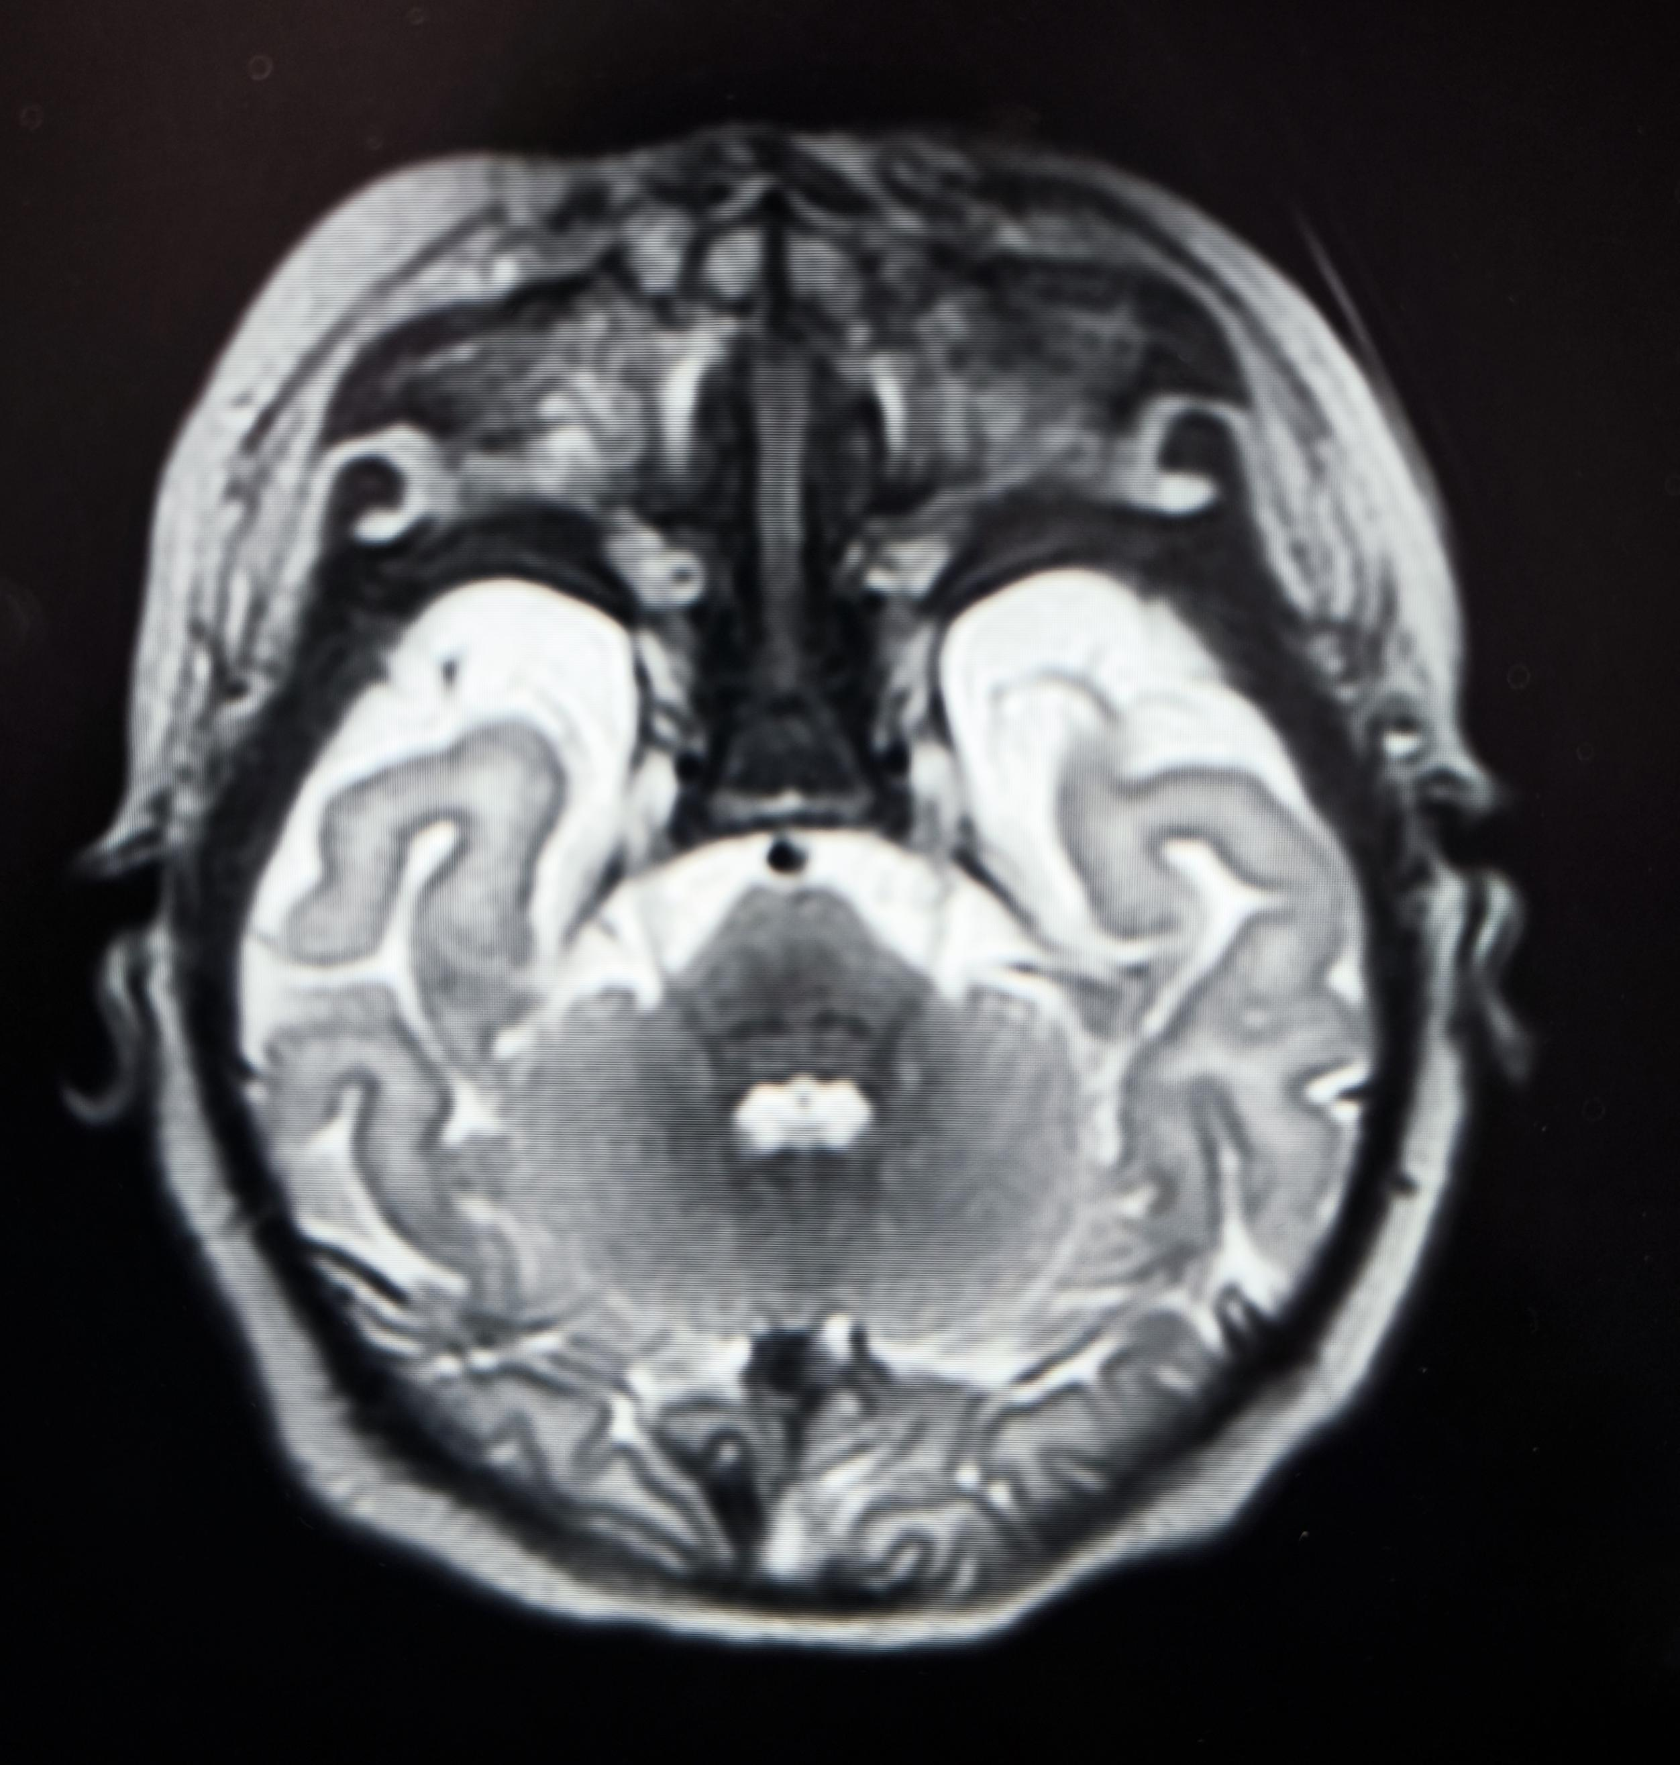
Axial T2-a
Axial T2-b
Sag T1
Sagittal T1 image demonstrates non visualisation of bony and cartilaginous parts of the nose (arhinia) (arrow Thick)
Axial T2-A showing lacrimal fossa cyst bilaterally larger on right side
Axial T2-b showing obliterated nasal cavity and paranasal sinuses are underdeveloped.

Slide 5
References:
1. Brasseur B, Martin CM, Cayci Z, Burmeister L, Schimmenti LA. Bosma arhinia microphthalmia syndrome: clinical report and review of the literature. Am J Med Genet A. 2016;170(1):38-49. doi:10.1002/ajmg.a.37400
2.Nguyen TA, Tran BT, Hoang TM, et al. Bosma Arhinia Microphthalmia Syndrome (BAMS): first report from Vietnam. Int J Otolaryngol Head Neck Surg. 2023;12(2):58-62. doi:10.4236/ijohns.2023.122007
3. Armağan C, Üçüncü Egeli T, Akyıldız C, et al. A newborn with arhinia: suspected BAM syndrome. J Dr Behcet Uz Child Hosp. 2023;13(1):34-38. doi:10.1002/jbuchd.18942

