Slide 1
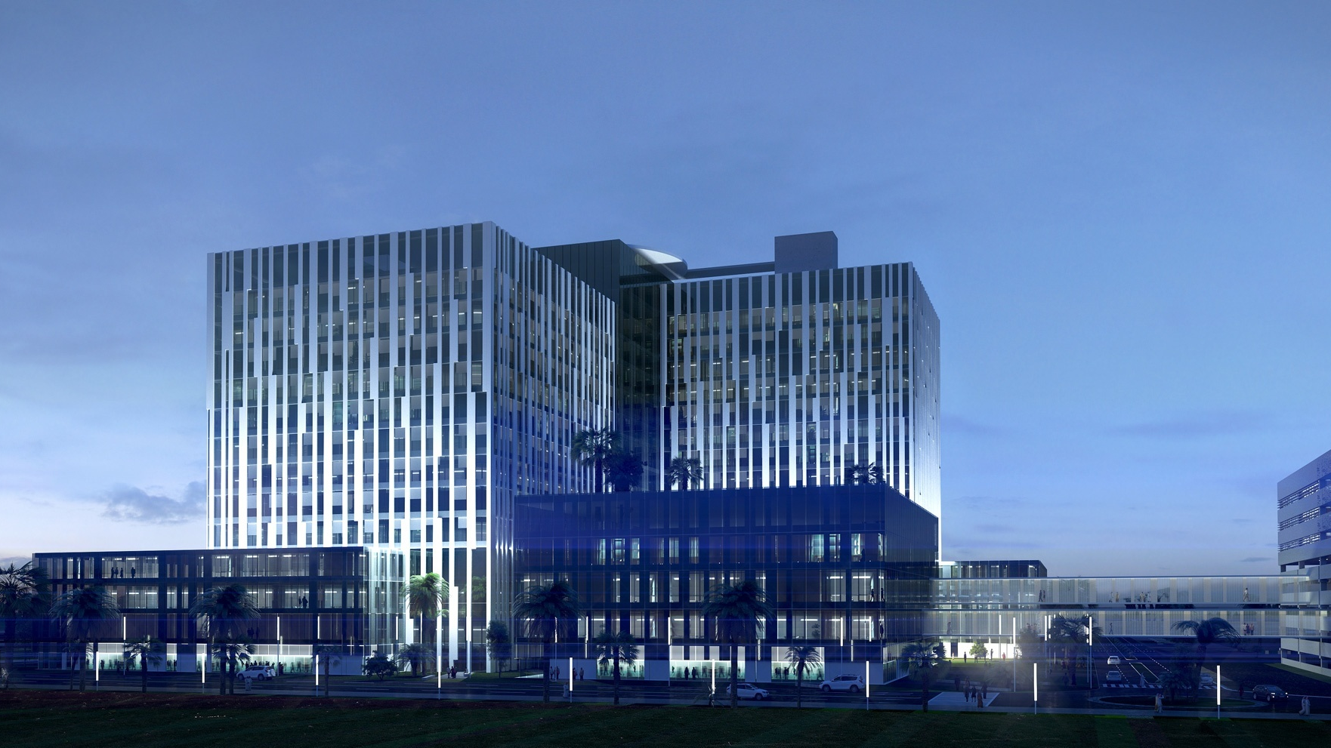
Lemierre Syndrome
Dr.salem Mohammad - KUWAITI BOARD OF RADIOLOGY , KIMS.
Dr. Safwat Almoghaz MD - Al-Adan radiology department.

Slide 2
Case synopsis and Final Diagnosis
Lemierre Syndrome
Patient: A 36 years old female presented with a history of sore throat, fever and neck pain, which had been treated with oral administration of antibiotics without response. At admission to the hospital, she was febrile and tachycardic with tender swelled neck.The patient had elevated levels of inflammatory markers; the radiograph of the chest obtained at admission was unremarkable.
Radiological Findings: On admission CT scans of the neck were obtained after the intravenous contrast administration. This showed left jugular venous distention with a thickened enhancing wall and a hypoattenuating filling defect consistent with septic thrombosis ,Edema of retropharyngeal space and surrounding soft tissues, incidentally apical lungs were covered in the scans of neck revealed peripheral cavitary lesion in left upper lobe and right pleural effusion, raising suspicion to Lemierre syndrome.Post admission CT scans of the chest showed multiple cavitary lesions with right pleural collections contain gas locules in keeping with pleural empyema.Upon discharge CT scans of neck and chest showed resolving of lung empyema , septic emboli and remaining jugular vein thrombosis with collateral formation.
Differential Diagnosis: isolated jugular vein thrombosis , isolated oropharyngeal infection ,pneumonia and metastatic disease.
Culture result : Fusobacterium necrophorum.
Pathology Findings: Not applicable.
Treatment and Prognosis: Intravenous antibiotics ,pleural collections requiring interventional percutaneous drainage with good outcome.

Slide 3
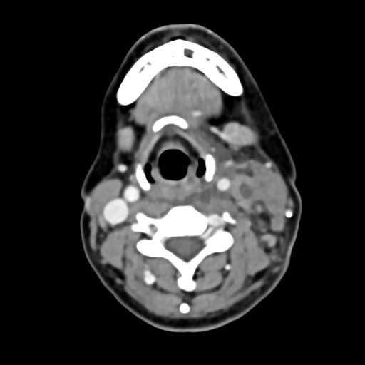
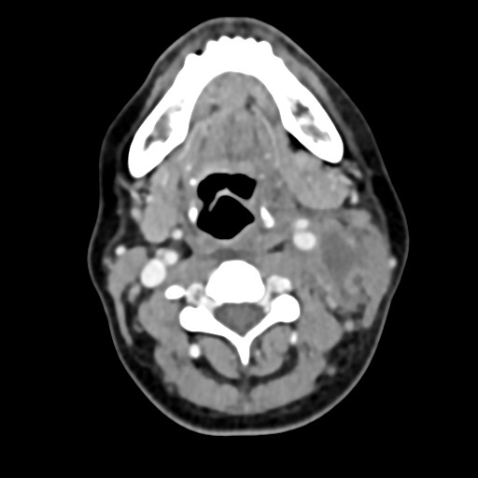
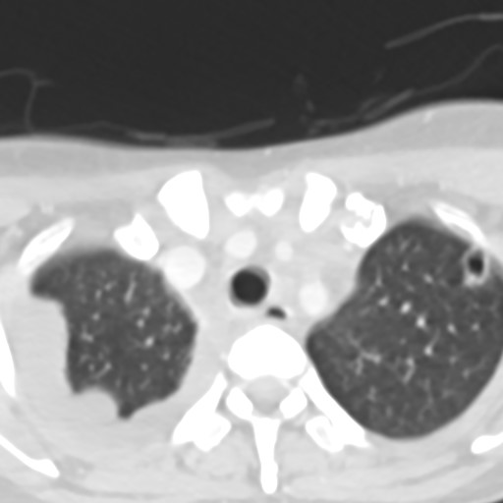
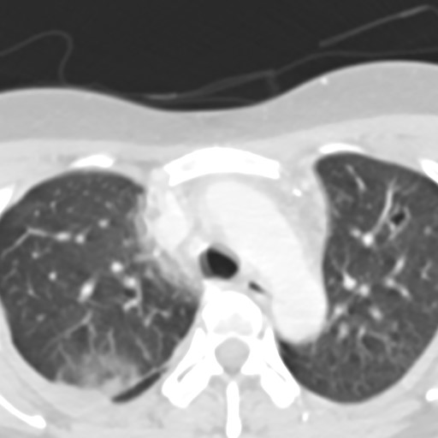
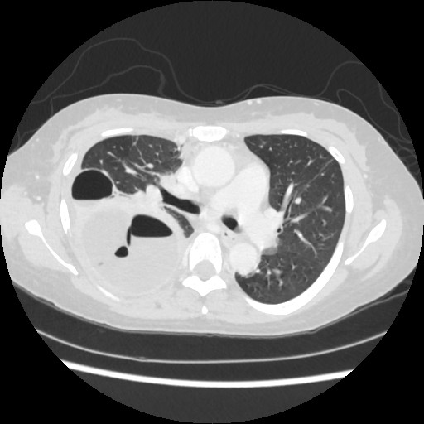
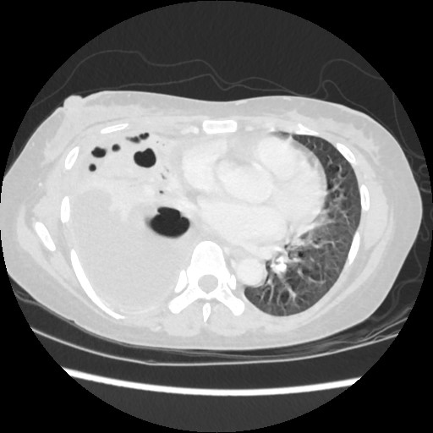
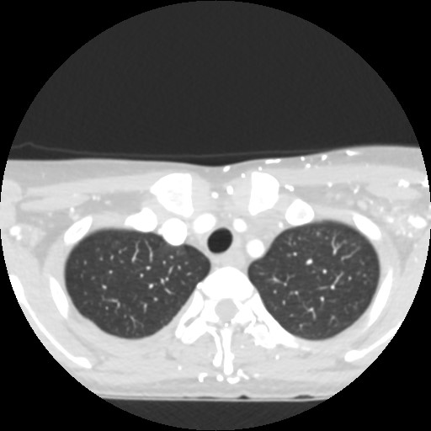
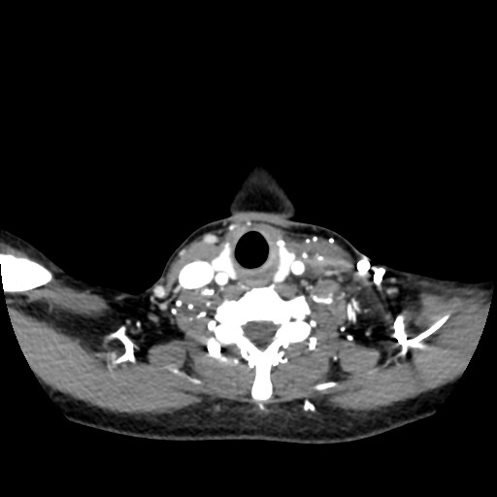
Lemierre Syndrome
Contrast enhanced CT neck
Contrast enhanced CT chest
A: presentation
A
A
A
A
Contrast enhanced CT chest
Contrast enhanced CT neck and chest.
B : post admsion
C : upon discharge
B
B
C
C
A: left jugular venous distention with a thickened enhancing wall and a filling defect consistent with septic thrombosis ( yellow arrows) and soft tissue edema (blue arrow).
A: peripheral cavitary lesion in left upper lobe (red arrows ).
B: Right pleural empyema with gas locules (orange arrows).
C :Resolving of septic emboli , right empyema with collateral formation (green arrows).

Slide 4
References:
Nicholas J. Screaton, James G. Ravenel, Paul J. Lehner, E. Robert Heitzman, Christopher D. R. Flower, Lemierre Syndrome: Forgotten but Not Extinct—Report of Four Cases. RSNA. Published Online:Nov 1 1999 https://doi.org/10.1148/radiology.213.2.r99nv09369.
6. Kim BY, Yoon DY, Kim HC et-al. Thrombophlebitis of the internal jugular vein (Lemierre syndrome): clinical and CT findings. Acta Radiol. 2013;54 (6): 622-7. doi:10.1177/0284185113481019 - Pubmed citation
Bell D, Di Muzio B, Sharma R, et al. Lemierre syndrome. Reference article, Radiopaedia.org (Accessed on 17 Jan 2025) https://doi.org/10.53347/rID-1576

