Slide 1
Non-Syndromic Bilateral Congenital Facial Nerves Aplasia
Dr.Zeyad Fadhl Shaif Moqbel
Specialist Radiologist .MD
Jahra Hospital
Kuwait

Slide 2
Case synopsis
Facial nerve aplasia is an extremely rare condition that is usually syndromic, namely; in Moebius syndrome, among others. The occurrence of isolated aplasia of facial nerve is even rarer, with only few cases reported in the literature.
It is classified as traumatic or developmental; unilateral or bilateral; and complete or incomplete
In our case we report a two-year-old female infant with bilateral congenital facial nerve palsy. The condition was noted at birth, manifesting as facial asymmetry during crying and an inability to close both eyes completely. The patient was born at term with vaginal delivery, with no history of perinatal trauma, birth asphyxia, or the use of instrumentation. Family history was unremarkable, and developmental milestones were appropriate for age.
On examination, bilateral lower motor neuron facial nerve palsy was confirmed, with the absence of dysmorphic features or other cranial nerve involvement.
High-resolution MRI revealed bilateral aplasia of the facial nerves. Other cranial nerves, including the cochlear and vestibular nerves, as well as the abducent nerves were intact.
Physiotherapy is the mainstay of treatment. Most patients regain some function in follow-up which may be due to aberrant innervations of some of the facial muscles by other cranial nerves
This case highlights the importance MRI in diagnosing congenital facial nerve aplasia and emphasizes the need for early multidisciplinary care to optimize outcomes in this rare condition.

Slide 3
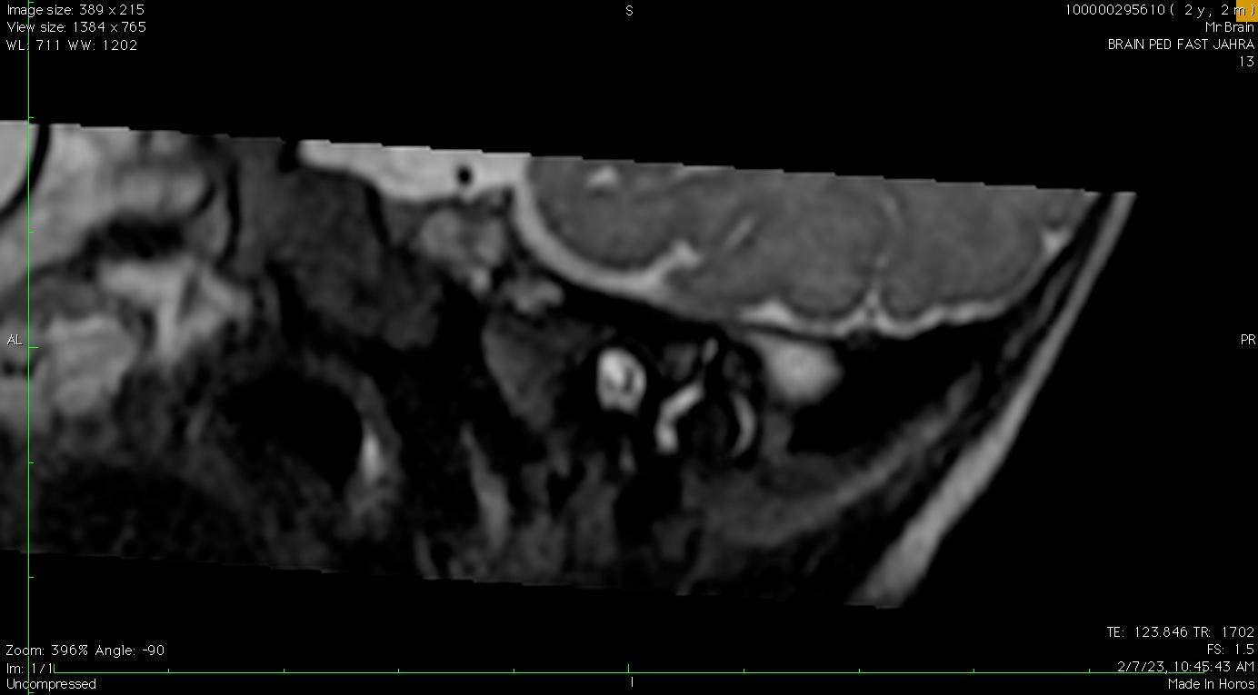
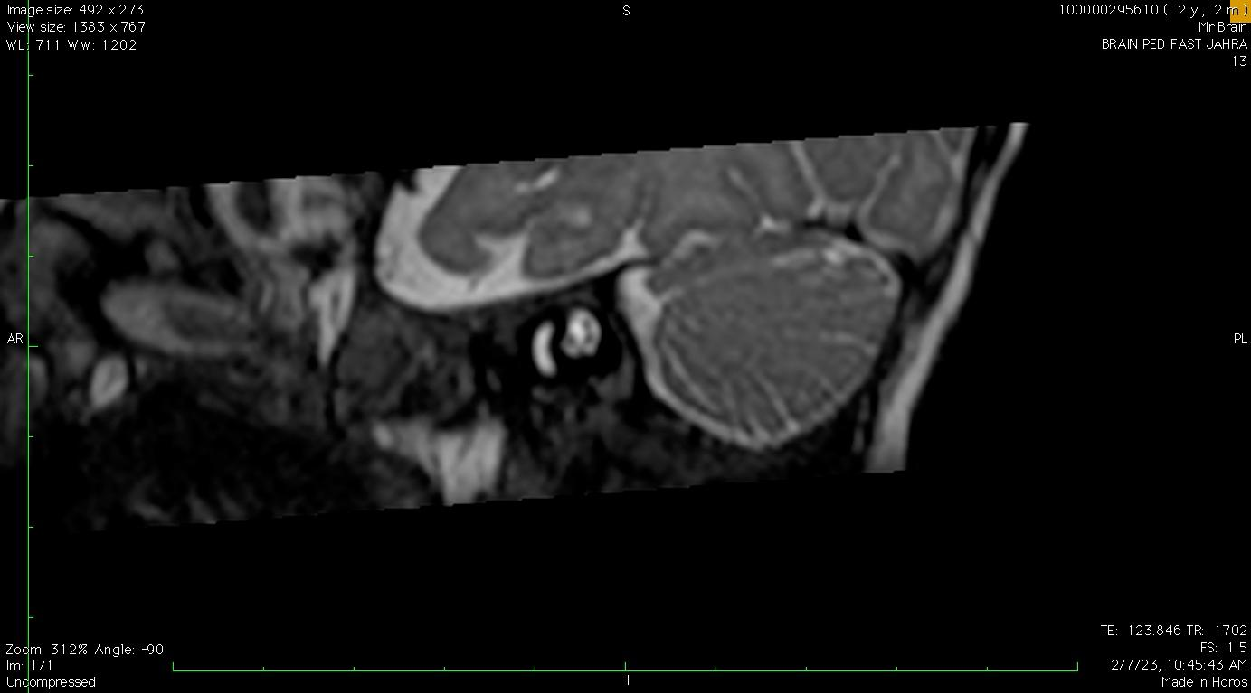
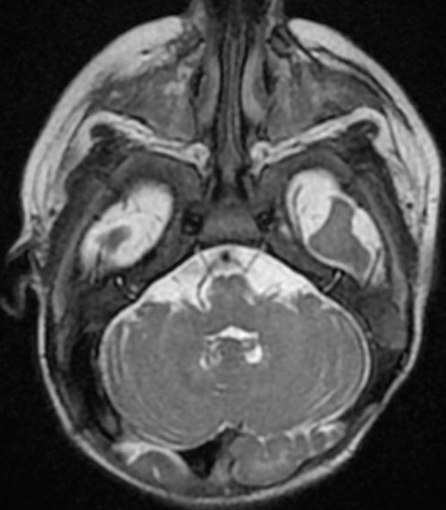
MRI FINDINGS:
Vestibular N
Vestibular N
Cochlear N
Cochlear N
B
A
MRI Sagittal oblique FIESTA right (A)and left(B) of the IAC revealed absence of both facial nerves (red arrows) .
MRI Axial T2 FIESTA Intact both abducent nerves(black arrows) , a finding excluding Moebius syndrome.

Slide 4
References
1.Nordjoe YE, Azdad O, Lahkim M, Jroundi L, Laamrani FZ. Congenital unilateral facial palsy revealing a facial nerve agenesis: a case report and review of the literature. BJR Case Reports. 2019;5(1):20180029. doi:10.1259/bjrcr.20180029.
2.Kumar I, Verma A, Ojha R, Aggarwal P. Congenital facial nerve aplasia: MR depiction of a rare anomaly. Indian J Radiol Imaging. 2016;26(4):517-520. doi:10.4103/0971-3026.195791.
3.Jervis PN, Bull PD. Congenital facial nerve agenesis. J Laryngol Otol. 2001;115(1):53-54. doi:10.1258/0022215011906795.

