Slide 1
Two lesion in one axial plane of Von Hippel–Lindau patient
Khalid Alsuhaibani – Neuroradiology Fellow
King Abdulaziz Medical City – National Guard Hospital, Riyadh, Saudi Arabia.

Slide 2
Clinical history, radiological findings and diagnosis.
31 years old male came through outpatient clinics complaining of tinnitus and vertigo, CT scan of the temporal bones and MRI of the brain were ordered and obtained.
CT showed left petrous bone mouth eaten lytic lesion at the expected location of the vestibular aqueduct.
MRI showed T1 and T2 hyperintense lesion at the expected location of the left vestibular aqueduct. Also, there is cystic lesion with enhancing mural nodule seen at the left cerebellum without significant mass effect.
It turns out to be endolymphatic sac tumor and hemangioblastoma, with further investigation the patient was labeled as Von Hippel–Lindau disease.

Slide 3
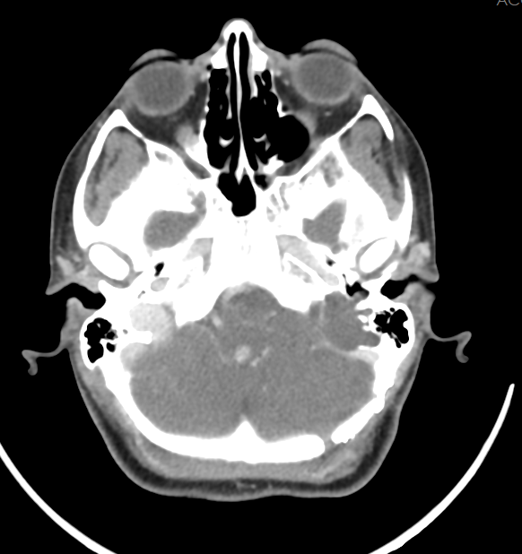
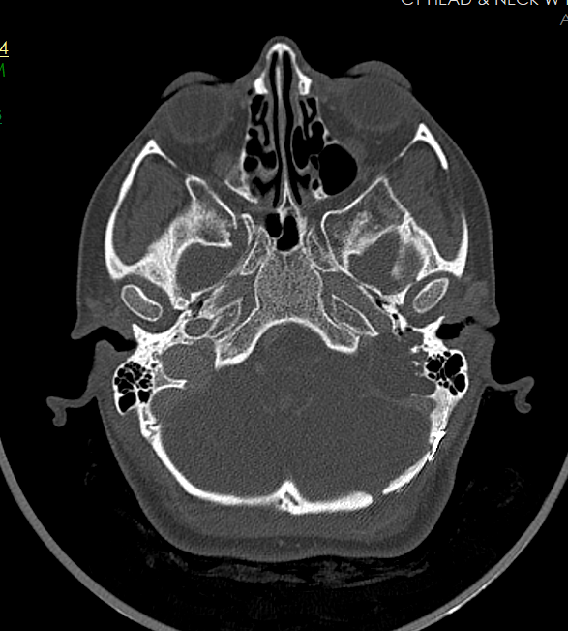

Slide 4
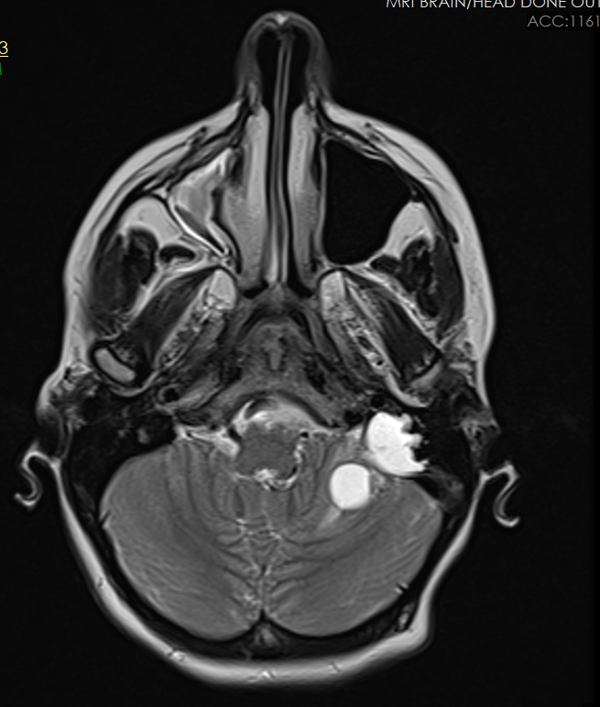
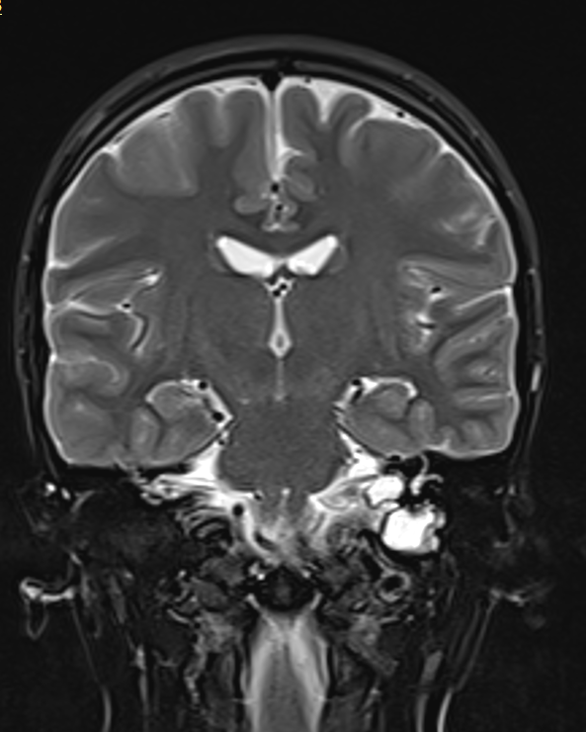
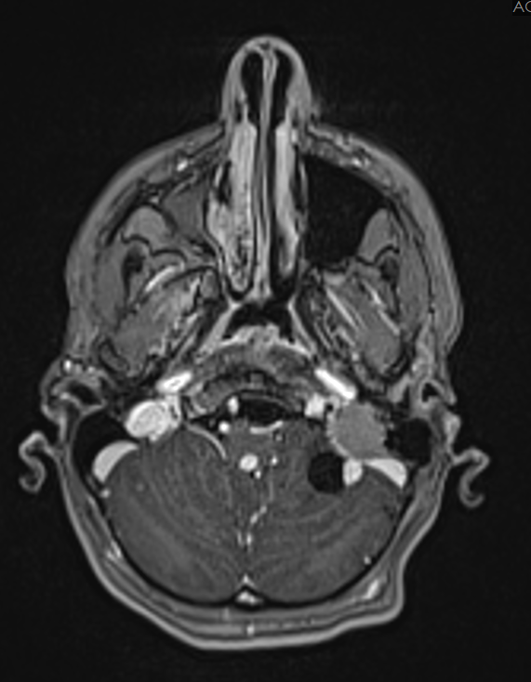
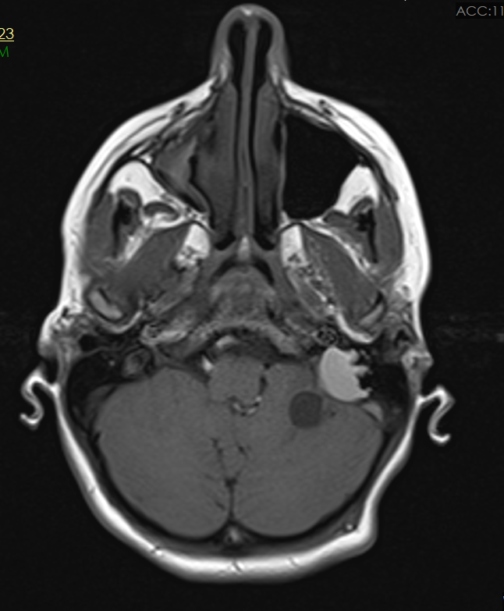

Slide 5
Reference
Tumors in von hippel–lindau syndrome: From head to toe—comprehensive state-of-the-art review | radiographics. Available at: https://pubs.rsna.org/doi/10.1148/rg.2018170156

