Slide 1
Odontoid process duplication
By
Dr. Sayed Awad ;MSc
Dr. Safwat Elmoghazy ;MD
Radiology department
Al-adan Hospital

Slide 2
Case synopsis and final diagnosis
Clinical and radiological findings:
18 Y/O male presented with trauma, headache and neck pain, to role out traumatic injuries.
Neck X-ray revealed block vertebra C2 to C6 . CT brain and cervical spine were performed. The imaging revealed no injuries related to trauma. But incidental findings as duplicated odontoid process ,unfused dorsal arch of C1 and C2:C6 vertebral fusion.
Differential diagnosis:
klippel feil Syndrome
Treatment and prognosis:
Symptomatic and conservative treatment.
Conclusion:
Rare incidental findings odontoid process duplication ,C2:C6 block vertebrae.

Slide 3
Abstract
Duplicated odontoid process is an extremely rare conginital anomally that has been reported in the literature [1-4]. It has been related to pituitary gland duplication and Klippel-Feil syndrome, the etiology and pathogenesis still understood [2, 3, 5]. Many other anatomical variants have been reported in association with odontoid malfor­mation, the most common being os odontoideum [1]. Other variants of the odontoid process include hypoplasia, aplasia, anteversion, malposition, odontoid process bicornis, ossiculum terminale, and fused odontoid process to the anterior arch of the atlas [1, 4, 5].
CT and MRI can evaluate detailed anatomy and narrow the differential [1, 5].
Management strategies for odontoid process duplication are less clear. Most cases presented with limited head rotation, numbness and paresthesias, or with extensive craniofacial abnormalities. About 50% of cases had normal neurological exams with no deficits appreciated during physical exam, the other half showed clear syndromic abnor­malities associated with Klippel Feil syndrome and midline craniofacial defects [1-4].

Slide 4
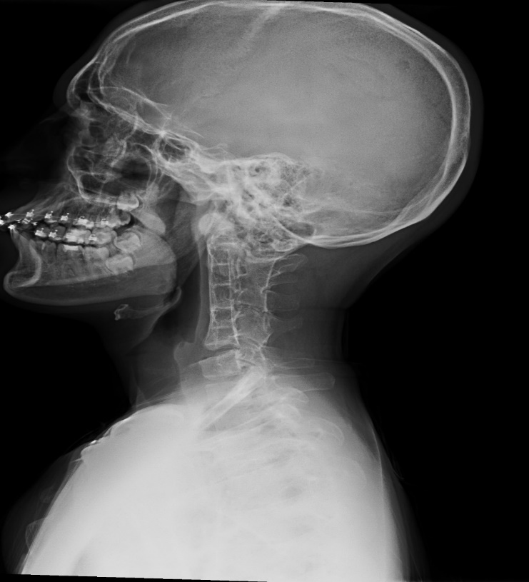
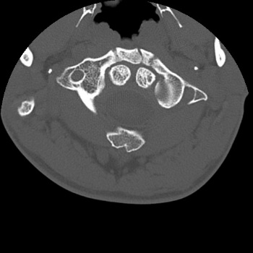
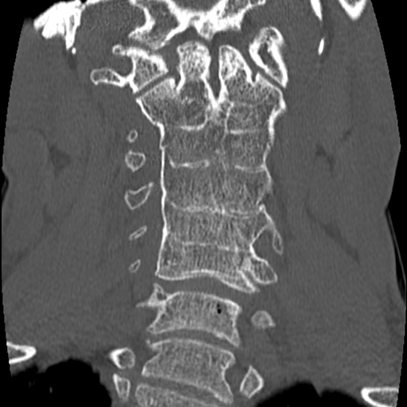
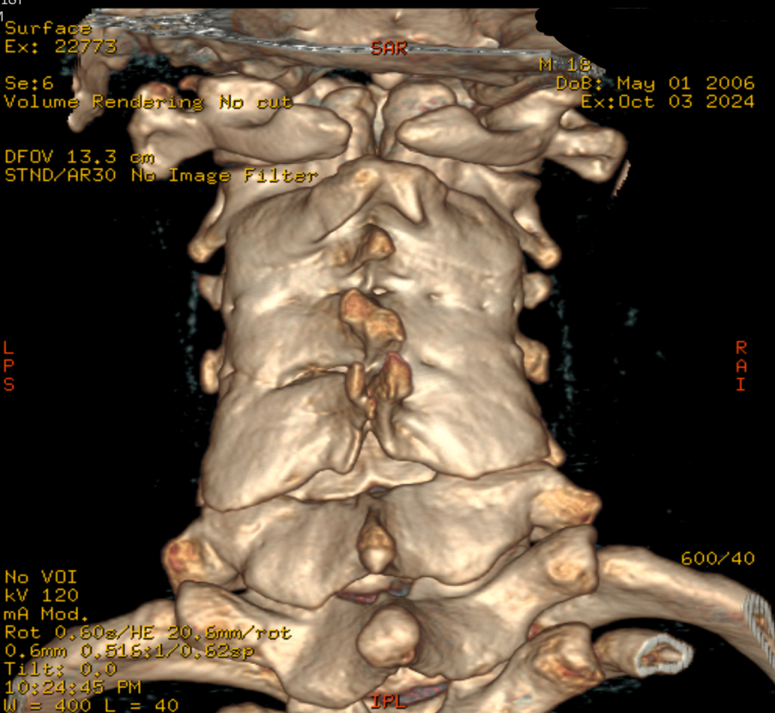
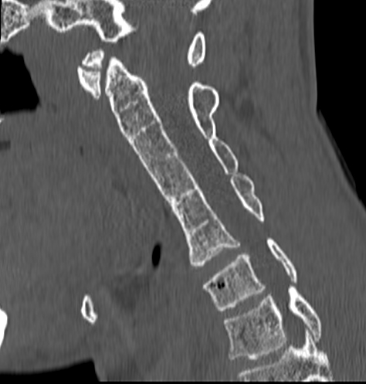
B
A
D
X-ray neck lateral veiw ( A) show block vertebra from C2 to C6 , Axial CT of cervical spine with sagital , coronal and 3D reformats (B,C ,Dand E ) : show duplicated odontoid process butterly C2 fusion of C2 to C6 vertebra bodies and posterior elements.(klippel-feil syndrome).
C
E

Slide 5
References
1.Garant M, Oudjhane K, Sinsky A, O'Gorman AM. Duplicated odontoid process: plain radiographic and CT appearance of a rare congenital anomaly of the cervical spine. AJNR Am J Neuroradiol 1997;18:1719-20.
2. Dilettoso S, Uccello M, Dilettoso A, Gelardi S, Dilettoso B. Duplicated odontoid process and atlas clefts associated to Klippel- Feil syndrome. Spine J 2012;12:449-50.
3. Manjila S, Miller EA, Vadera S, Goel RK, Khan FR, Crowe C, Geertman RT. Duplication of the pituitary gland associated with multiple blastogenesis defects: duplication of the pituitary gland (DPG)-plus syndrome. Case report and review of literature. Surg Neurol Int 2012;3:23.
4. Usta Y, Sakha F, White WL, Little AS, Knecht L. Duplicated pituitary gland and odontoid process. A case report. Neuroradiol J 2012;25:360-3.
5.Akobo S, Rizk E, Loukas M, Chapman JR, Oskouian RJ, Tubbs RS. The odontoid process: a comprehensive review of its anatomy, embryology, and variations. Childs Nerv Syst 2015;31:2025- 34.

