Slide 1
Mycotic Aneurysm Of The Internal Carotid Artery And Cerebral Hemorrhagic Infraction Secondary To Deep Neck Infection
Dr.haytham Ramzy ELZIAT
radiology consultant adan hospital

Slide 2
Patient and clinical Information:
A 43-year-old female presenting with a dental infection, accompanied by left-sided neck swelling. She also exhibits developed altered level of consciousness, fifteen days later, the swelling increased in size and became pulsatile.
Radiological Findings:
The initial CT scan of the neck and brain reveal a left-sided neck abscess involving the left submandibular region, extending into the left carotid space. There is also evidence of thrombophlebitis of the left internal jugular vein, which extends into the left sagittal sinus. This progression has resulted in hemorrhagic infarcts in the left cerebral hemisphere.
A follow-up MRI, performed 15 days later, reveals the formation of a new pseudoaneurysm in the left internal carotid artery, with a blood signal extending into the abscess. This finding was subsequently confirmed by CT angiography.
Final Diagnosis:
A left submandibular abscess complicated by left-sided thrombophlebitis, cerebral hemorrhagic infarction, and a ruptured mycotic aneurysm of the left internal carotid artery.
Prognosis: Mycotic carotid aneurysms are associated with high morbidity and mortality, with potential complications, including rupture, fistulation, airway compromise and stroke.
Treatment: The literature uniformly support the combined strategy of antibiotic therapy and prompt endovascular repair.

Slide 3
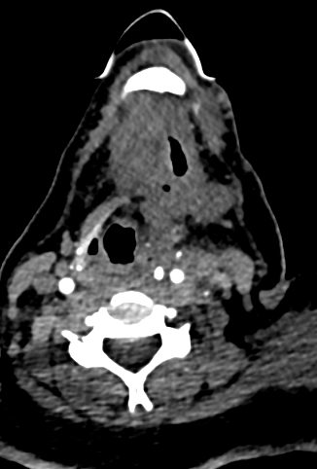
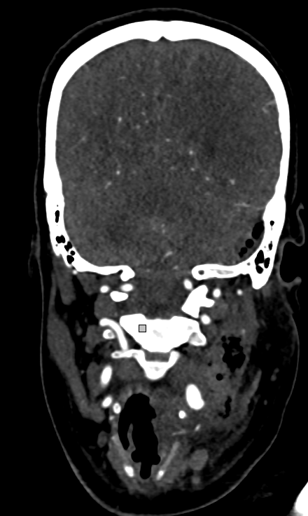
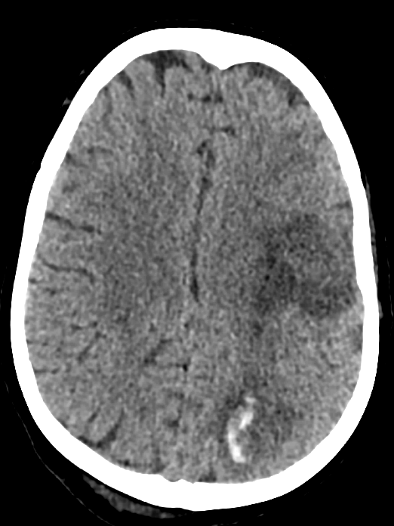
CT scans of the neck and brain with contrast reveal a left submandibular neck abscess (orange arrow), accompanied by thrombophlebitis of the left internal jugular vein (red arrow), extending into the sigmoid sinus (blue arrow). This progression is associated with subsequent left cerebral hemorrhagic infarcts (green arrow).

Slide 4
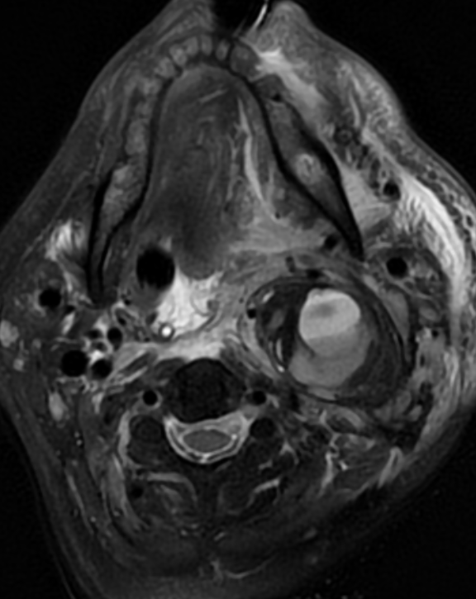
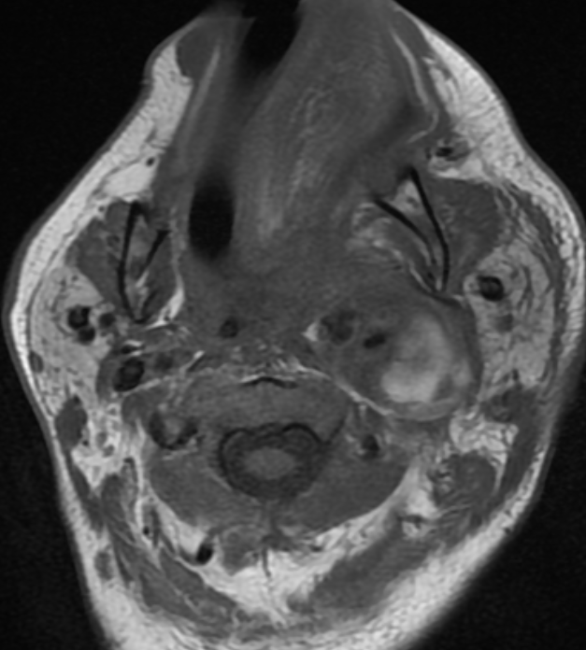
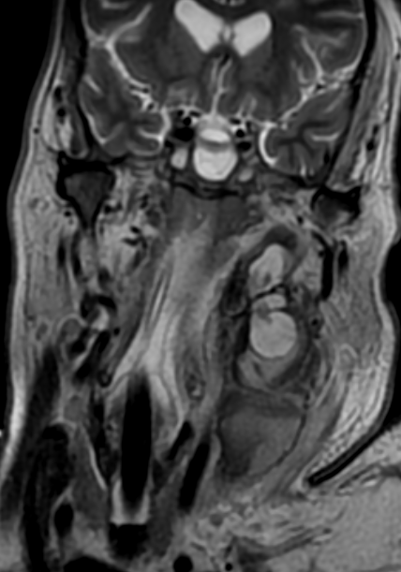
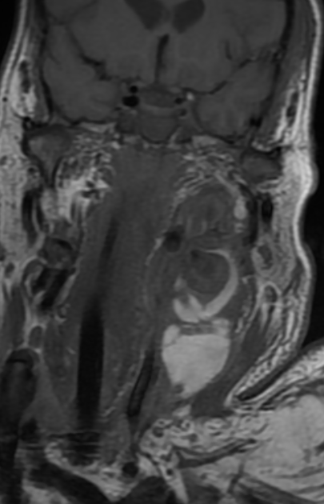
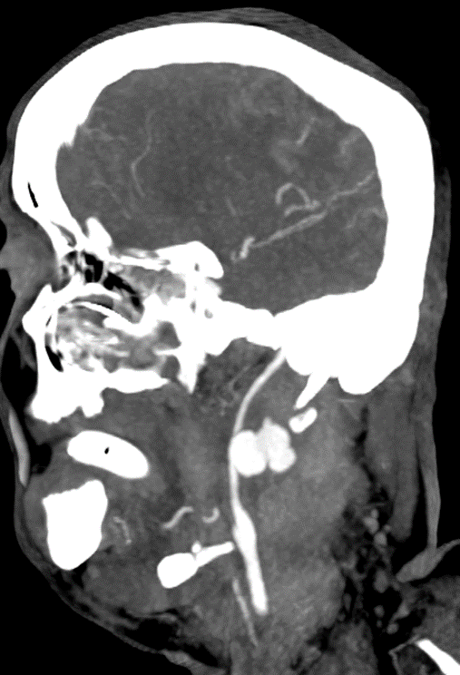
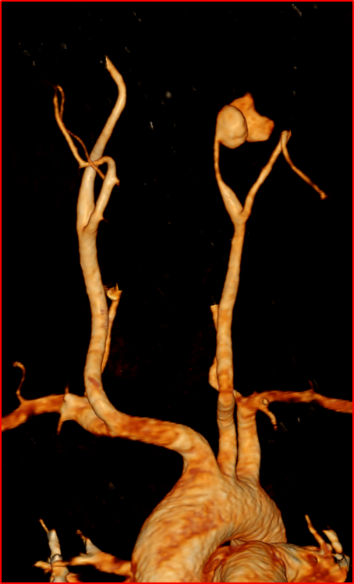
MRI of the neck without contrast (T1 and T2WIs axial and coronal) 15 days latter reveals a newly developed pseudoaneurysm of the left internal carotid artery (red arrows), surrounded by blood signal intensity, suggesting a ruptured pseudoaneurysm extending into the neck abscess (orange arrows).
CT carotid angiography (volume rendering and sagittal MIP) confirms the presence of a left internal carotid pseudoaneurysm (blue arrow).

Slide 5
Reference:
1.Jebara V.A., Acar C., Dervanian P., Chachques J.C., Bischoff N., Uva M.S., et al. Mycotic aneurysms of the carotid arteries--case report and review of the literature. J Vasc Surg. 1991;14:215–219. doi: 10.1067/mva.1991.28089.
2.Kasangana K., Shih M., Saunders P., Rhee R. Common carotid artery pseudoaneurysm secondary to Mycobacterium tuberculosis treated with resection and reconstruction with saphenous vein graft. J Vasc Surg Cases Innov Tech. 2017;3:192–195. doi: 10.1016/j.jvscit.2017.06.006.
3.Kenyon O., Tanna R., Sharma V., Kullar P. Mycotic pseudoaneurysm of the common carotid artery: an unusual neck lump. BMJ Case Rep. 2020;13:e239921. doi: 10.1136/bcr-2020-239921.

