Slide 1
Isolated Stapes otosclerosis
Dr. Athbi Athab¹, Dr. Hussam AlNeil²
1 Senior Radiologist, Al Amiri Hospital.
2 Consultant Radiologist, Al Sabah Hospital.

Slide 2
A 22 year-old male patient presented with progressive left sided hearing loss of several months duration. No otalgia, tinnitus, otorrhea or vertigo. There was no known family history of hearing impairment.
Clinical examination revealed normal tympanic membrane and conductive pattern of hearing loss (50dB)
Patient was referred for HRCT of the petrous temporal bone which revealed subtle demineralization/ hypo-density at the stapes suprastructure with involvement/obliteration of the oval window. Normal round window, facial nerve canal, jugular bulb, middle ear cavity, rest of ossicular chain and inner ear. Normal right ear.
Radiological diagnosis of isolated stapes otosclerosis was suggested and further confirmed by audiological testing which revealed left air-bone gap (30dB) and absent stapedial reflexes.
The patient was referred for surgical stapedectomy and prosthesis insertion.

Slide 3
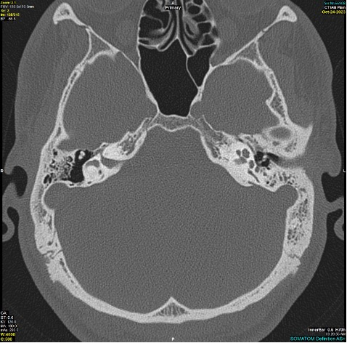
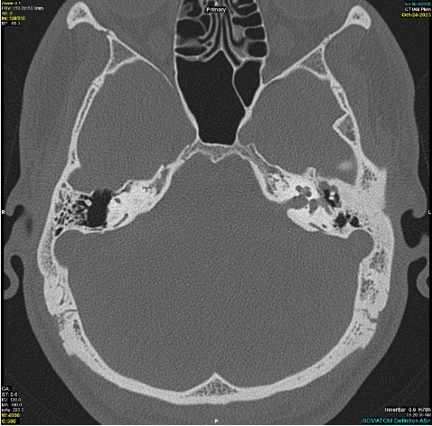
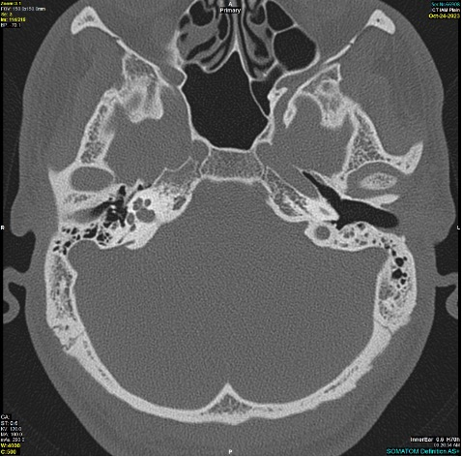
Images (1&2): Axial HRCT of the petrous bones showing; Focal subtle demineralization at the Stapes (Blue arrowhead) and the ovale window (blue arrow).
Image (3): Axial HRCT of the petrous bones for comparison with the normal right stapes appearance. (green arrow)
(1)
(2)
(3)

Slide 4
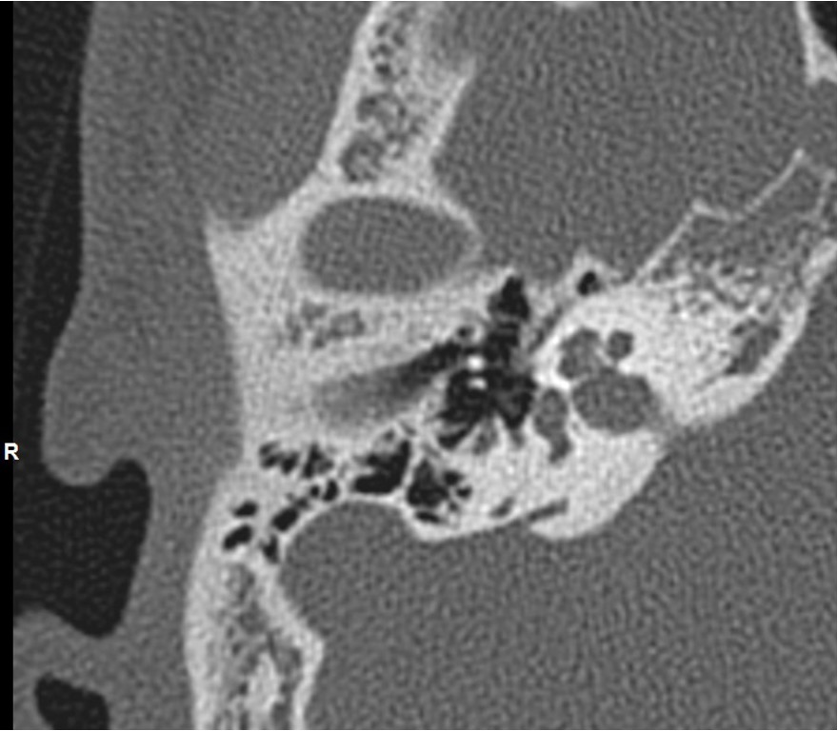
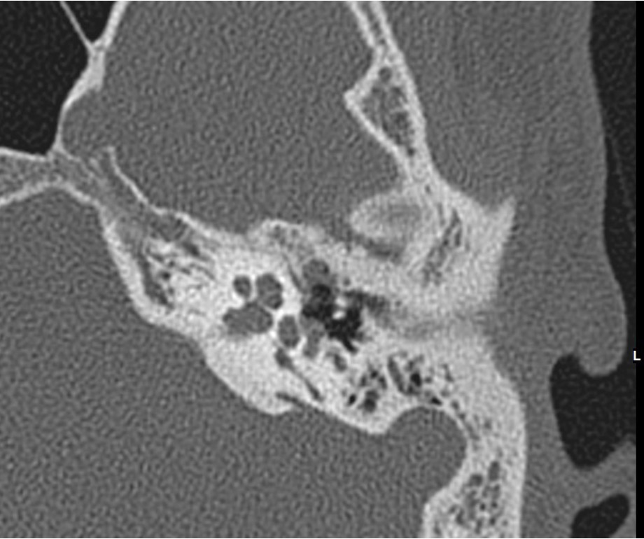
Right Stapes well defined foot plate with no abnormal Lucency or demineralization. (Blue arrow)
Left stapes; demineralization and loss of the stapes foot plate (green arrow) with involvement of the Ovale window (blue arrowhead).

Slide 5
Literature references
Kim, K. W., Jun, H., Im, G. J., Chang, J. W., Kwon, S. Y., Chae, S. W., Jung, H. H., & Choi, J. (2011). Isolated otosclerosis of the incus in a Korean woman. Auris Nasus Larynx, 38(5), 654–656. https://doi.org/10.1016/j.anl.2010.12.015
De Souza, C., & Glasscock, M. E. (2004). Otosclerosis and stapedectomy: Diagnosis, Management, and Complications. Thieme.
Purohit, B., Hermans, R., & De Beeck, K. O. (2014). Imaging in otosclerosis: A pictorial review. Insights Into Imaging, 5(2), 245–252. https://doi.org/10.1007/s13244-014-0313-9

