Slide 1
Solitary Metastatic Cystic Neck Lesion in Occult Papillary Thyroid Carcinoma
Dr. Fatma Magdy Salama, Specialist Radiologist Al-Sabah Hospital
Dr. Hossam Elnil, Consultant Radiologist Al-Sabah hospital

Slide 2
The papillary thyroid carcinoma (PTC) is the commonest thyroid cancer with tendency to early cervical nodal metastasis. To the best of our knowledge the presentation of papillary thyroid carcinoma as a solitary cervical nodal cystic lesion with radiologically occult primary thyroid cancer is rare and reported only in few cases in the literature.
We present a case of 37 -year- old female patient who presented with left lateral mid/lower neck mass related to the sternocleidomastoid muscle.
MRI was done and revealed left lateral cervical complex cystic lesion deep to the sternomastoid muscle, displaying high T1 and intermediate T2 WIs signal with levelling, no suppression at FAT SAT images denoting hemorrhagic content, with enhancing solid component. It also shows foci of internal calcification exhibiting hypointense signal in all sequences. No other neck lesions. Normal MRI appearance of the thyroid gland.
Our primary diagnostic impression was necrotic pathological lymph node. The intrinsic high T1WI signal of the lesion and the presence of calcification raised the concern for metastatic LN from PTC, however other atypical carotid space lesions couldn't be totally excluded.
FNAC was done and confirmed the diagnosis of metastatic pathology from PTC .
Patient underwent total thyroidectomy and surgical excision of the metastatic lymph node followed by radio-active iodine-131 ablation.
On follow up whole body iodine scan was done, revealed only remnant thyroid tissue at the left thyroid bed with no detectable distant metastasis.

Slide 3
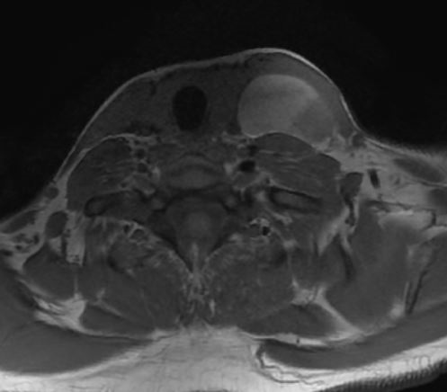
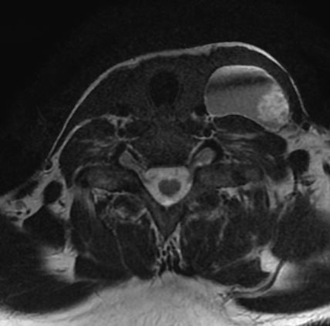
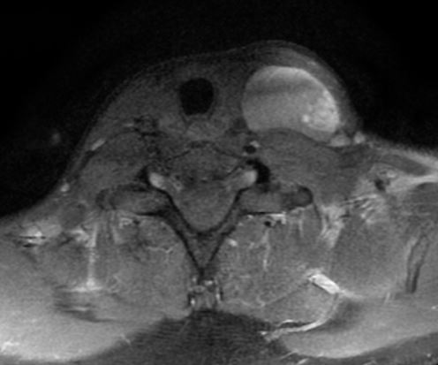
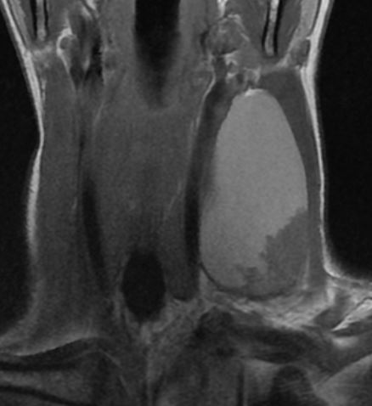
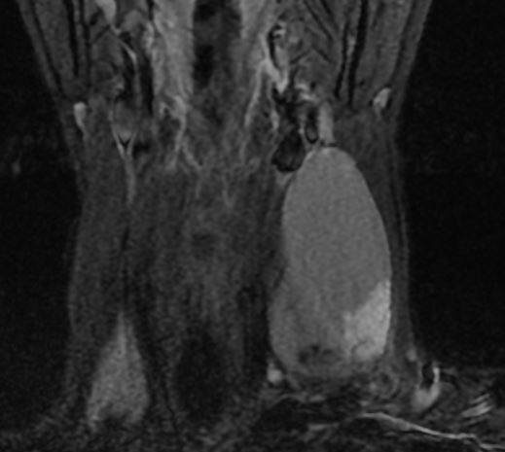
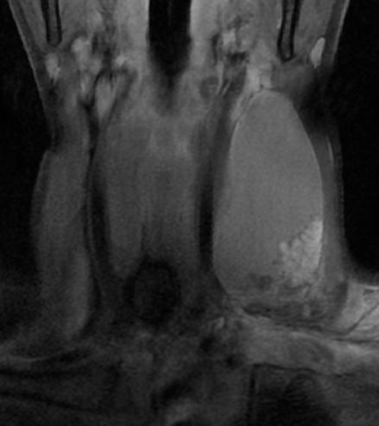
A
B
C
D
E
F
A. Axial T1WI, B. axial T2 WI, C. axial post contrast, D. coronal T1WI, E. coronal fat saturated T2WI, F. coronal post contrast. A well defined left lateral cervical complex cystic lesion, displacing the sternocleidomastoid muscle anterolaterally (white arrow) and the CCA medially (white arrow head). It shows mainly high T1 signal and intermediate T2 signal with an enhancing soft tissue component (green arrow). Small hypointense foci of calcification noted within the cyst (green arrow head).

Slide 4
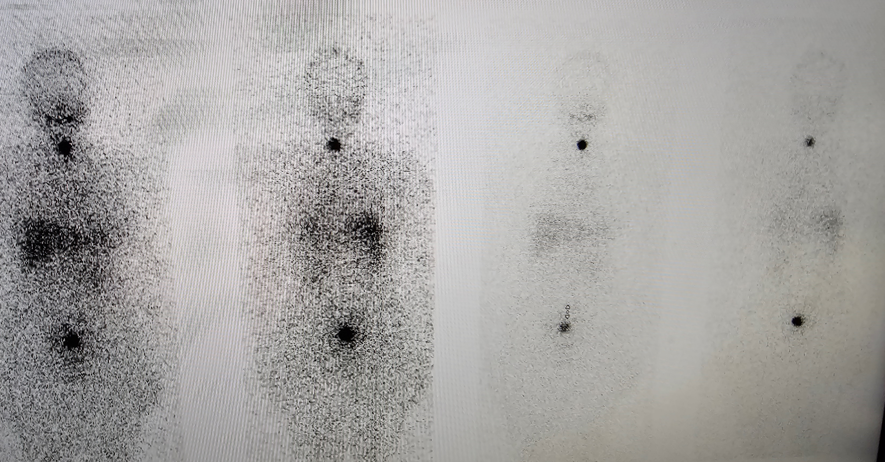
Whole body iodine scan shows a focal tracer uptake in the left thyroid bed (white arrow). No other abnormal tracer uptake in the rest of the body.

Slide 5
References:
1. Patrick W., Mukesh G. H., Peter F. H, et al. Cystic Lymph Node Metastases in Papillary Thyroid Carcinoma. AJR. 2002;178:693–697
2. Almaimani G., Forst F., Zoedler T and Almaimani B. An unusual presentation of papillary thyroid carcinoma in the lateral aspect of the neck. Int J Case Rep Imag. 2016;7(5):296–299
3. Sota M., Takashi H., Hirofumi K., et al. Imaging Approach for Cervical Lymph Node Metastases from Unknown Primary Tumor. RadioGraphics. 2022; 43(3):e220071. https://doi.org/10.1148/rg.220071
4. Jenny K.H., Barton F.B., Andreia R.G. et al. Imaging of thyroid carcinoma with CT and MRI: approaches to common scenarios. Caner imaging. 2013; 13(1): 128-139

