Slide 1
Lipoid Proteinosis of the larynx
Urbach-Wiethe disease
Hyalinosis cutis et mucosae
By: Prof.Dr. Sherif Shama
Consultant Radiologist, Sheikh Jaber Al-Ahmad Al-Sabah Hospital, Kuwait
Professor Of Radio-diagnosis, Head and Neck imaging Unit, Department of Radio-diagnosis, Faculty Of medicine, University Of Alexandria, Egypt.

Slide 2
  13 years old female patient presented with stridor and needed urgent tracheostomy
Urgent CT showed calcified laryngeal mass lesion mimics laryngeal neoplasm.
The mass was trans-glottic involving both aryepiglottic folds extends down to left true vocal cord with subglottic extension.
No extra-laryngeal extension.
Scans through the brain showed bilateral, symmetrical, horn-shaped (comma-shaped) calcifications within the medial temporal lobe of the brain affecting the amygdala.
Carful history revision: she had history of Lipoid Proteinosis with characteristic skin lesions (Moniliform blepharosis) and Psychiatric features (absence of fear, hallucinations, delusions).
Endoscopy and biopsy were performed and LP depositions were pathologically confirmed.

Slide 3
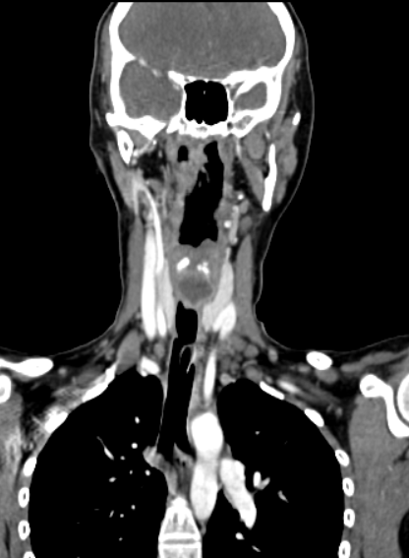
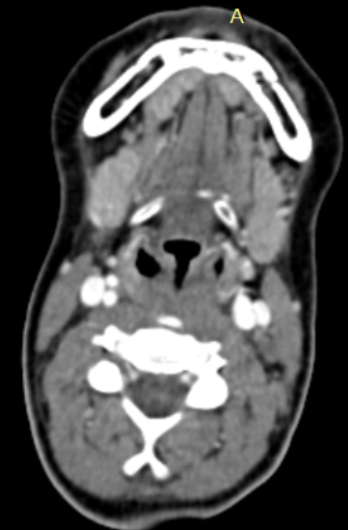
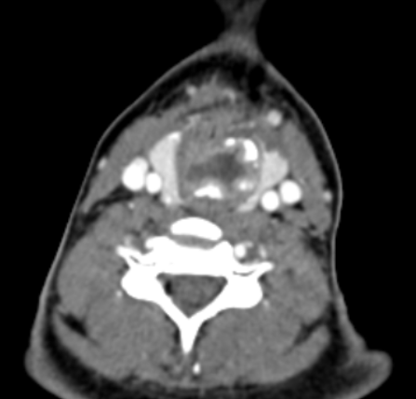
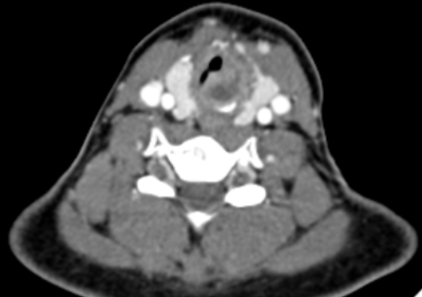
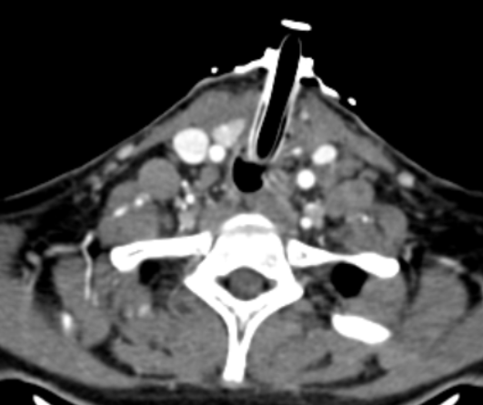
B
A
C
CT scans for pathologically proven LP showing depositions within both aryepiglottic folds (arrows in A), calcified mass mimics laryngeal tumor (arrows in B, C), involvement of the left true vocal cord (arrow in D). The patient needed tracheostomy (E).
D
E

Slide 4
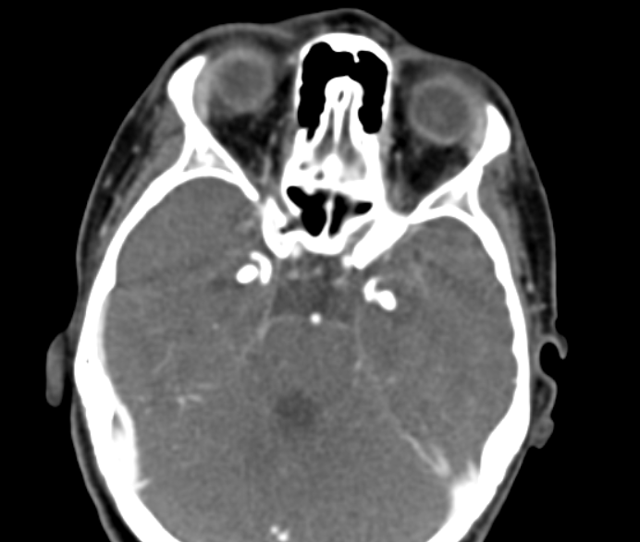
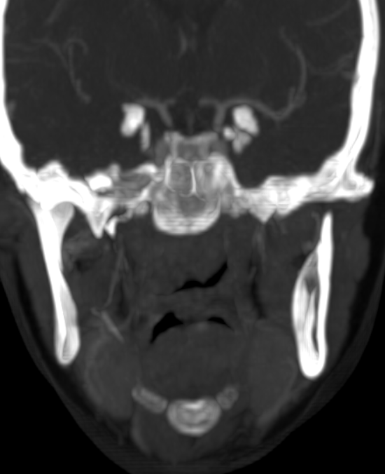
CT Scans through the brain showed bilateral, symmetrical, horn-shaped (comma-shaped) calcifications within the medial temporal lobe of the brain Characteristically affecting the amygdala (arrows).

Slide 5
References
Staut CCV, Naidich TP. Urbach-Wiethe Disease(Lipoid Proteinosis). Pediatric Neurosurgery. 1998;28(4):212-214. doi:https://doi.org/10.1159/000028653
Parida JR, Misra DP, Agarwal V. Urbach-Wiethe syndrome. BMJ Case Reports. Published online September 2, 2015:bcr2015212443. doi:https://doi.org/10.1136/bcr-2015-212443.
The case of SM, the fearless woman - Bytesize Science. YouTube. Published October 28, 2013. Accessed January 4, 2025. https://youtu.be/2Hi3JO1rqYw?si=ecRJBugkBt-aCgAz.
Sharma R, Bell D, Knipe H, Urbach-Wiethe disease. Reference article, Radiopaedia.org (Accessed on 04 Jan 2025) https://doi.org/10.53347/rID-57147

