Slide 1
Monostotic Mandibular Caffey’s Disease– Case Report
WALAA ABDULLAH GOUDA¹ , EMAN AKARY² , AMAL HASSAN EL SABAGH³
CONSULTTANT FARWANIYA HOSPITAL. ASSISTAN PROFESSOR OF RADIODIAGNOSIS MENOFIA UNIVERSITY. EGYPT.
SENIOR OF RADIODIAGNOSIS FARWANIYA HOSPITAL ( MD& FRCR).
SENIOR OF RADIODIAGNOSIS FARWANIYA HOSPITAL.

Slide 2
History:
A 5 -month-old female child complained of swelling of the left cheek with fever and irritability. The swelling is hard, fixed to the bone, red and painful.
Imaging findings:
CT shows diffuse left mandibular expansion, hyperostosis (with abundant hyper ostotic changes of the cortical & subcortical parts of the bone with loss of normal trabeculation) and subperiosteal bone formation. Associated with diffuse related enhancing soft tissue swelling involving the masticator space and the related masseter and pterygoid muscles as well as subcutaneous edema. Multiple variable sized mildly enlarged lymph nodes are noted at the upper and lower deep cervical groups more on the left side at the group IIa.
MR: shows the diffuse left mandibular expansion and the related soft tissue thickening of T1 hypointense and T2 hyperintense signal with marrow edema, cortical thickening, periosteal reaction and mild diffusion restriction. Post contrast scans show marked rather homogeneous marrow enhancement and diffuse enhancement of the related soft tissue swelling.
Final diagnosis: Monostotic mandibular Caffey Disease (Pathohistological proved).
Discussion:
Caffey disease, also referred to as infantile cortical hyperostosis, is a self-limiting inflammatory disease of bone, typically diagnosed in infancy (ages less than five months). This disease is characterized by asymmetric, often polyostotic bony hyperostosis and expansion, with a predilection for the mandible (70-90%).
Treatment supportive treatment (e.g., nonsteroidal anti-inflammatory drugs) was giving with spontaneous resolution of symptoms and no recurrence.

Slide 3
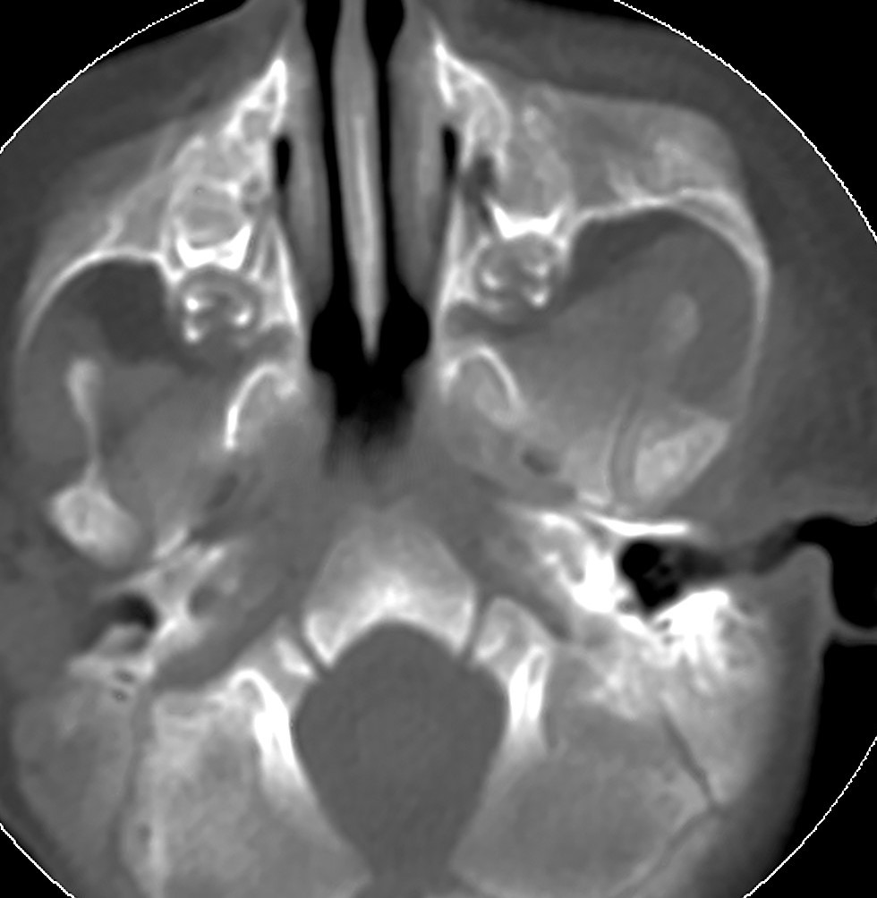
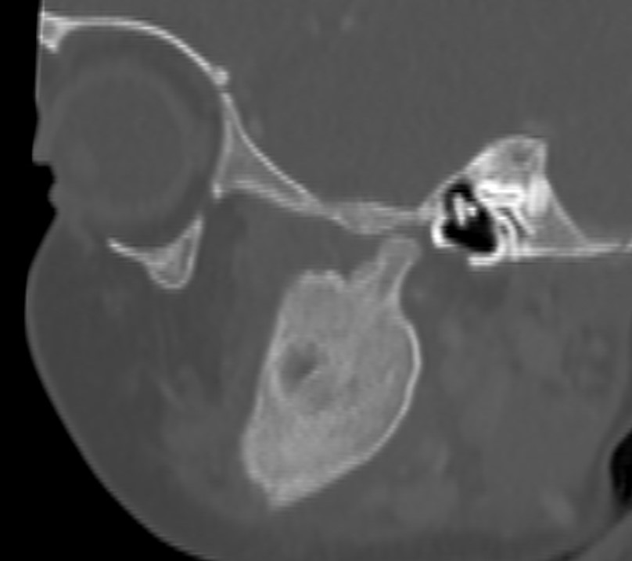
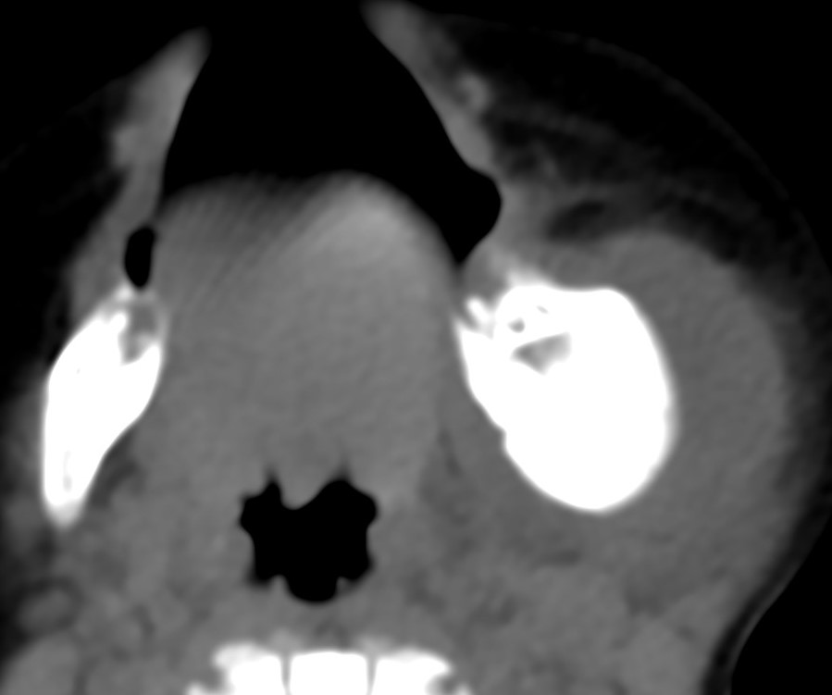
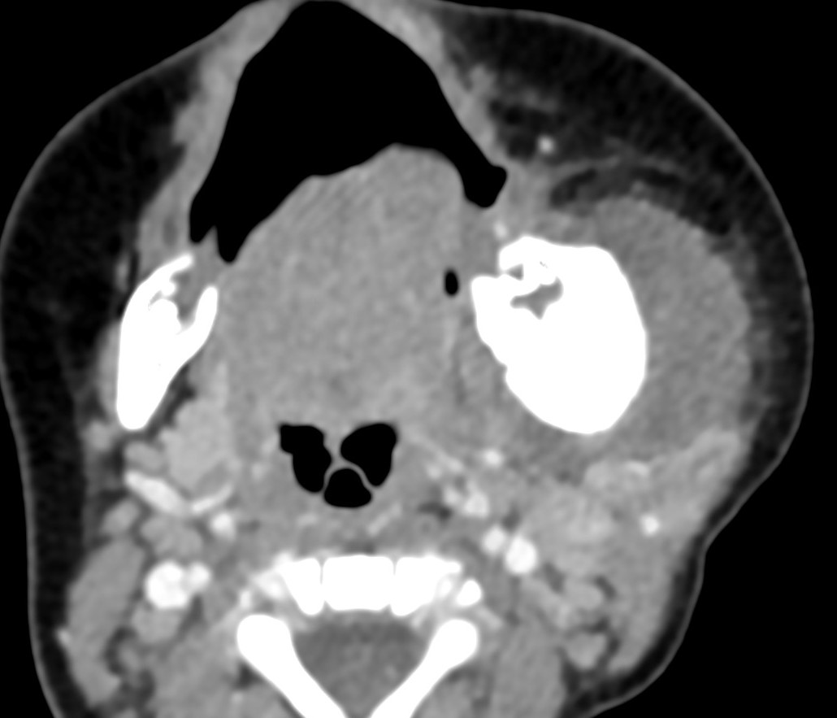
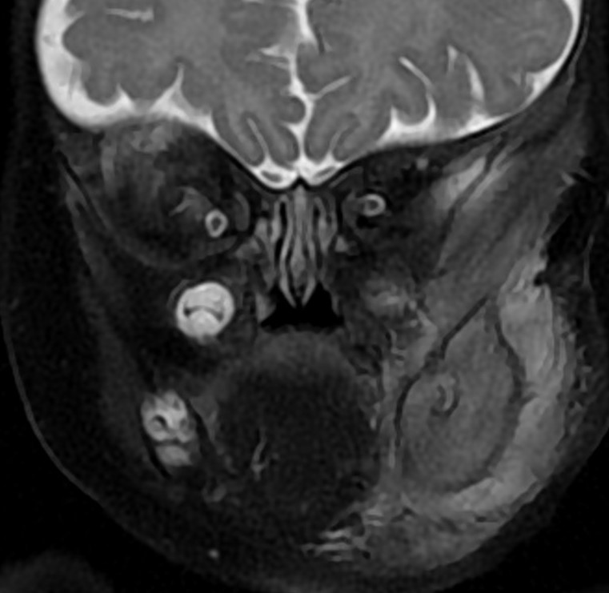
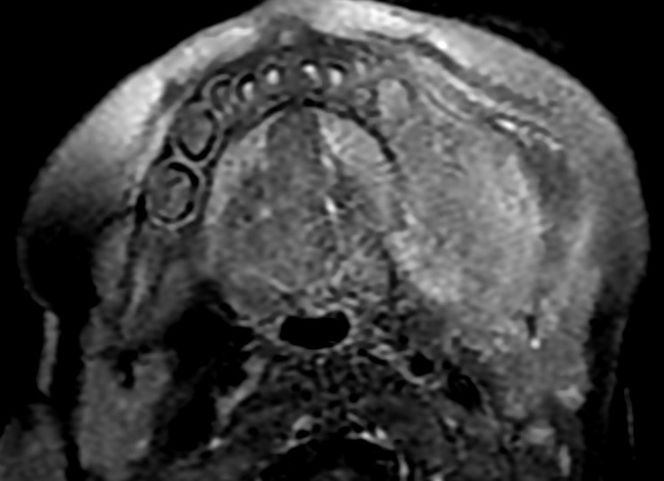
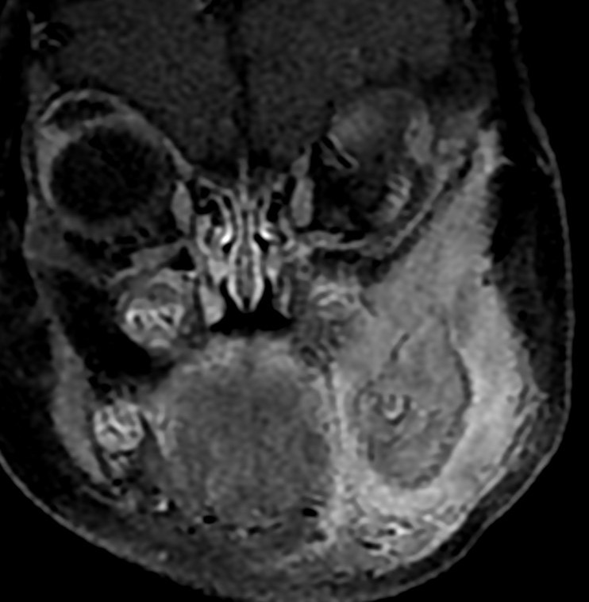
A
B
C
D
E
F
G
H
CT images, : A& B Axial and sagittal bone window: showing left mandibular diffuse expansion with abundant hyper ostotic changes of the cortical and subcortical parts of the bone and loss of normal trabeculation (green arrow). C&D axial pre and post contrast images: show diffuse related enhancing soft tissue swelling (white arrow) as well as mildly enlarged group II a lymph nodes.
MR: E& F: axial T1 and coronal T2 Fat Sat showing the diffuse left mandibular expansion and the related soft tissue thickening display T1 hypointense and T2 hyperintense signal with cortical thickening and periosteal reaction. G & H axial and coronal post contrast: showing avid rather homogenous enhancement of the left mandibular lesion and the related soft tissue thickening.

Slide 4
References:
Ksenija Kova, Tomislav F. Hajn, et al. Mandibular Caffey’s Disease– Case Report. Coll. Antropol. Case report. 2007 1: 359–361.
Kumari M, Prasad SN, Meena A, et al. Monostotic femoral Caffey disease masquerading as Ewing sarcoma. BMJ Case Rep. 2024 Sep 30;17(9):e261790.
Chapman T, Menashe SJ, Taragin BH. Radiographic overlap of recurrent Caffey disease and chronic multifocal osteomyelitis (CRMO) with consideration of molecular origins. Pediatr Radiol. 2020 May;50(5):618-627.

