Slide 1
IgG4-related disease (IgG4-RD)
Orbital apex and skull base involvement
By: Prof.Dr. Sherif Shama
Consultant Radiologist, Sheikh Jaber Al-Ahmad Al-Sabah Hospital, Kuwait
Professor Of Radio-diagnosis, Head and Neck imaging Unit, Department of Radio-diagnosis, Faculty Of medicine, University Of Alexandria, Egypt.

Slide 2
58 years female patient presented with gradual long-standing left sided propotosis with visual disturbance and trigeminal neuralgia
-Her MRI revealed markedly enhancing space occupying lesion targeting the left orbital apex surrounding the optic nerve.
-The lesion showed T2 low signal.
-Extension into the left Meckel’s cave and left cavernous sinus.
-Peri-neural spread along mandibular division of the trigeminal nerve (V3) reaching the masticator space.
-Extension to the left pterygo-palatine fossa and along the left infra-orbital nerve.
-The extra-ocular muscles were thickened and hyper-enhancing .
-Serum IgG4 level was elevated (>135 mg/dL).
-Due to high risk biopsy, systemic glucocorticoids were started and the patient improved clinically and on follow-up laboratory and radiological investigations.

Slide 3
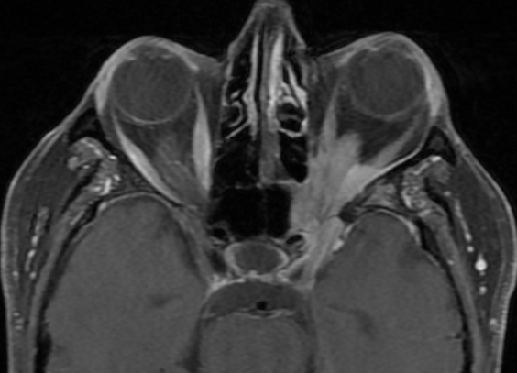
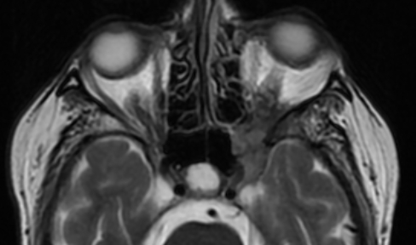
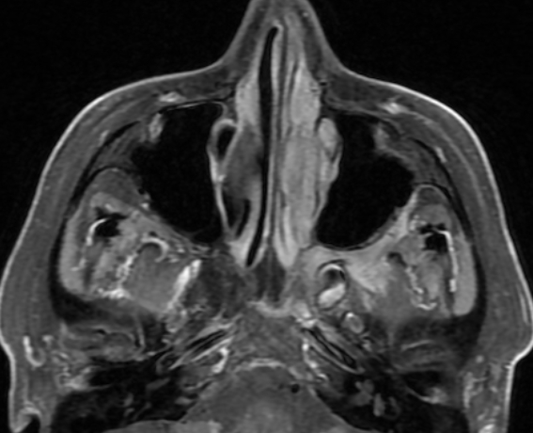
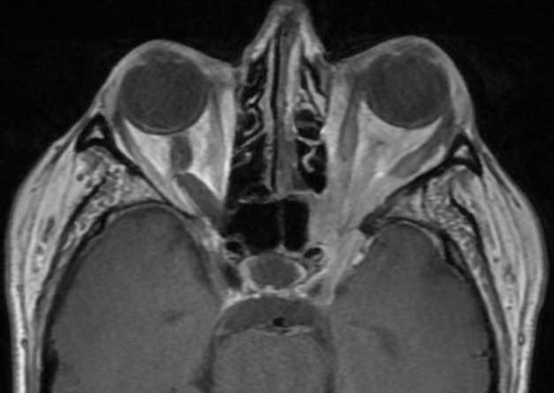
A
B
C
-Markedly enhancing SOL targeting the left orbital apex, surrounding the optic nerve (arrow in A, axial T1 fat sat +C).
-The lesion is showing T2 low signal (arrow in B, axial T2 WI)
-It is reaching the left pterygo-palatine fossa (arrow in C, axial T1 fat sat +C).
-The extra-ocular muscles are thickened and hyper-enhancing (arrow in D axial T1 fat sat +C).
D

Slide 4
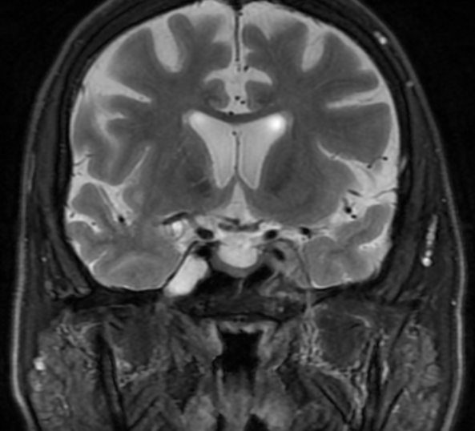
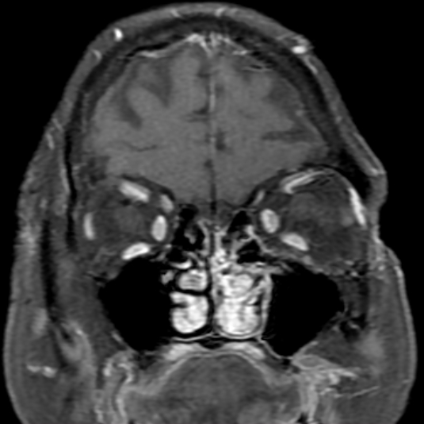
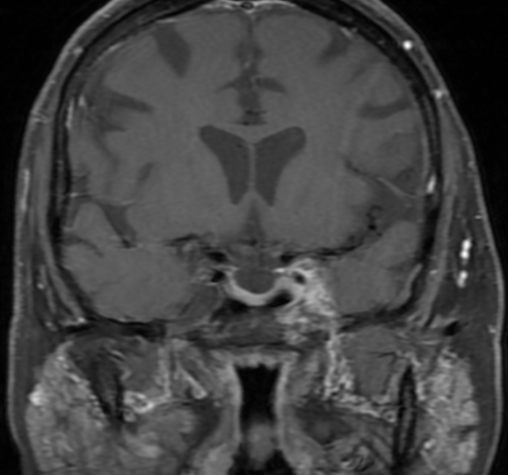
E
F
G
The lesion is implicating the left Meckel’s cave ( arrow in E, Coronal T2WI).
-Peri-neural Extension along the left V3 down to masticator space (arrow in F, coronal T1 fat sat +C).
G, coronal T1 fat sat +C showed hyper-enhancement of the extra-ocular muscle and enhancing left infra-orbital nerve (arrow).

Slide 5
References
Horger M, Lamprecht HG, Bares R, et al. Systemic IgG4-Related Sclerosing Disease: Spectrum of Imaging Findings and Differential Diagnosis. American Journal of Roentgenology. 2012;199(3):W276-W282. doi:https://doi.org/10.2214/ajr.11.8321.
Kamisawa T, Okamoto A. IgG4-related sclerosing disease. World Journal of Gastroenterology. 2008;14(25):3948. doi:https://doi.org/10.3748/wjg.14.3948.
Weerakkody Y, Jones J, Schultz K, et al. IgG4-related disease. Reference article, Radiopaedia.org (Accessed on 04 Jan 2025) https://doi.org/10.53347/rID-17290
Koch BL, Surjith Vattoth, Chapman PR. Diagnostic Imaging: Head and Neck - E-Book. Elsevier Health Sciences; 2021.

